Slide 1
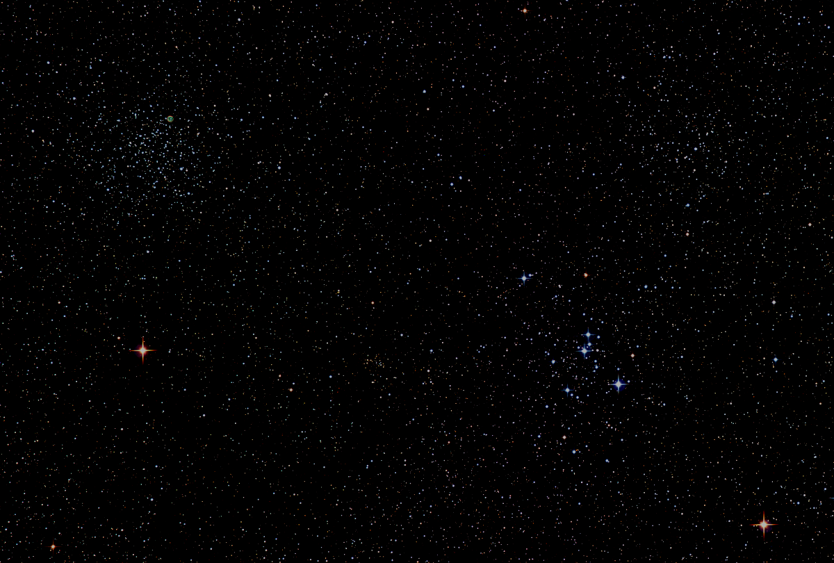

Howard
Astronomical
League
21
March 18, 2021
Notes:
Howard Astronomical League, February 20, 2020

Slide 2
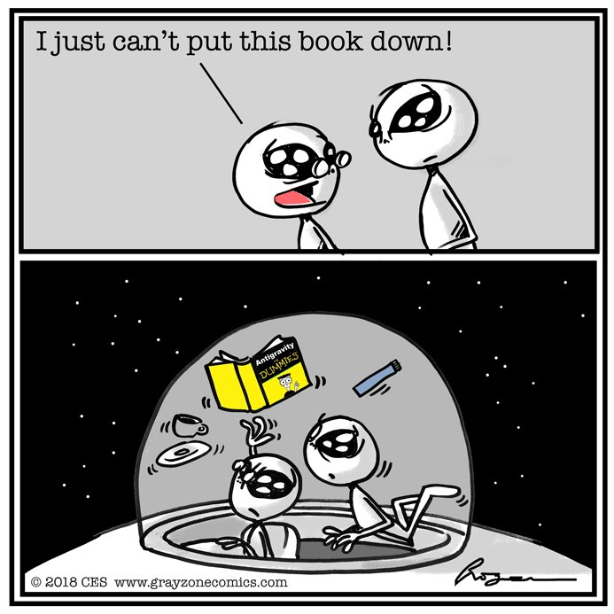
Astro Humor

Slide 3
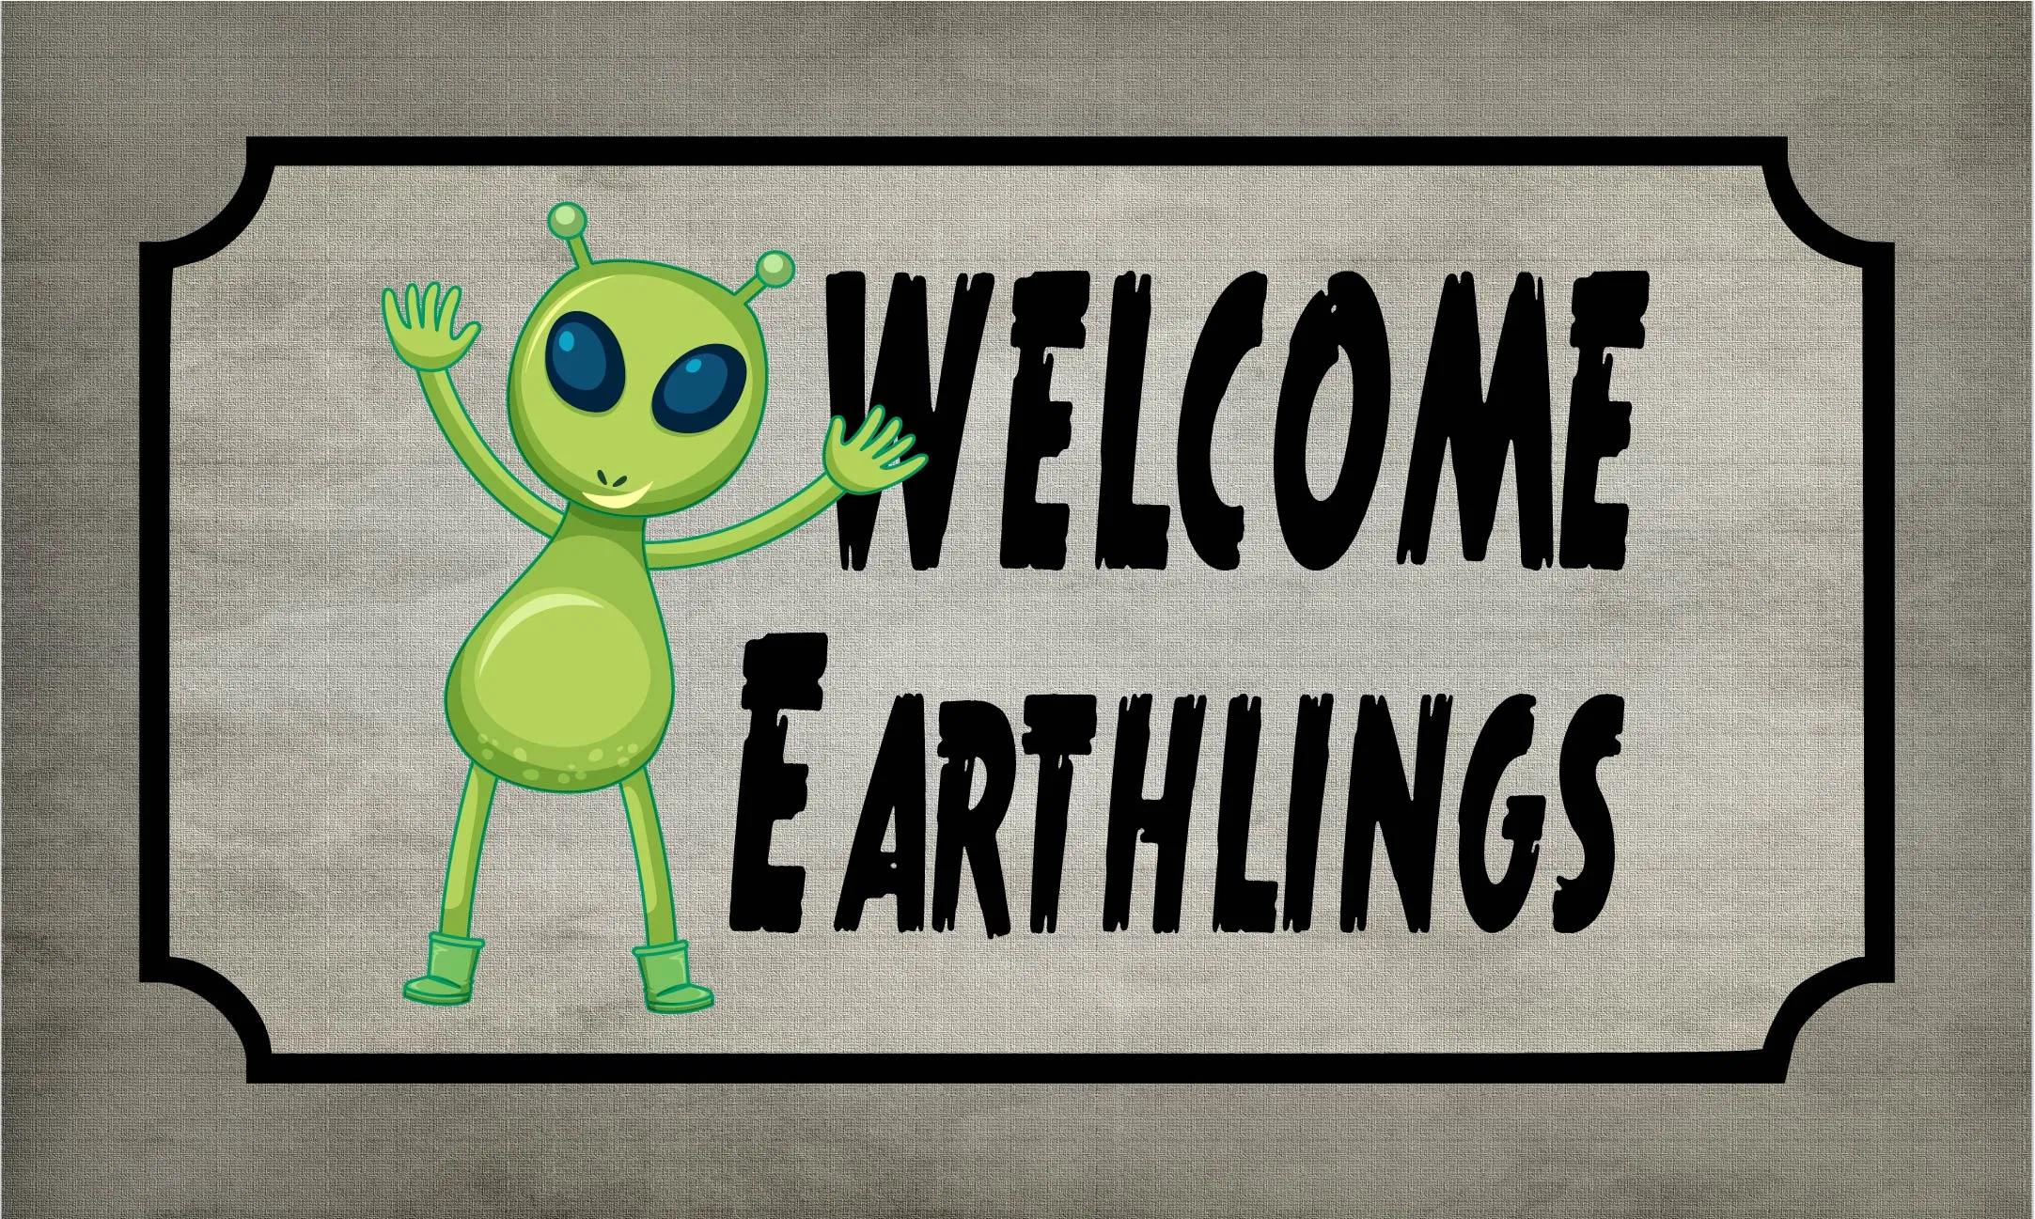
Welcome New Members and Guests

Slide 4
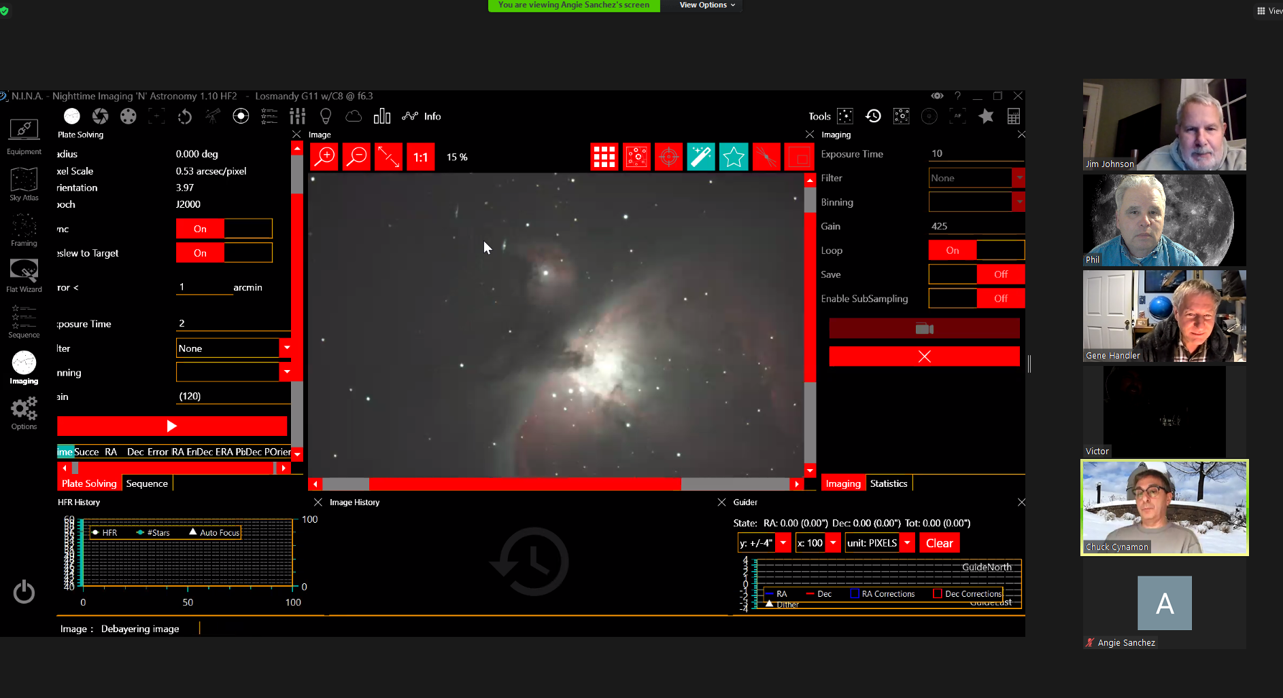
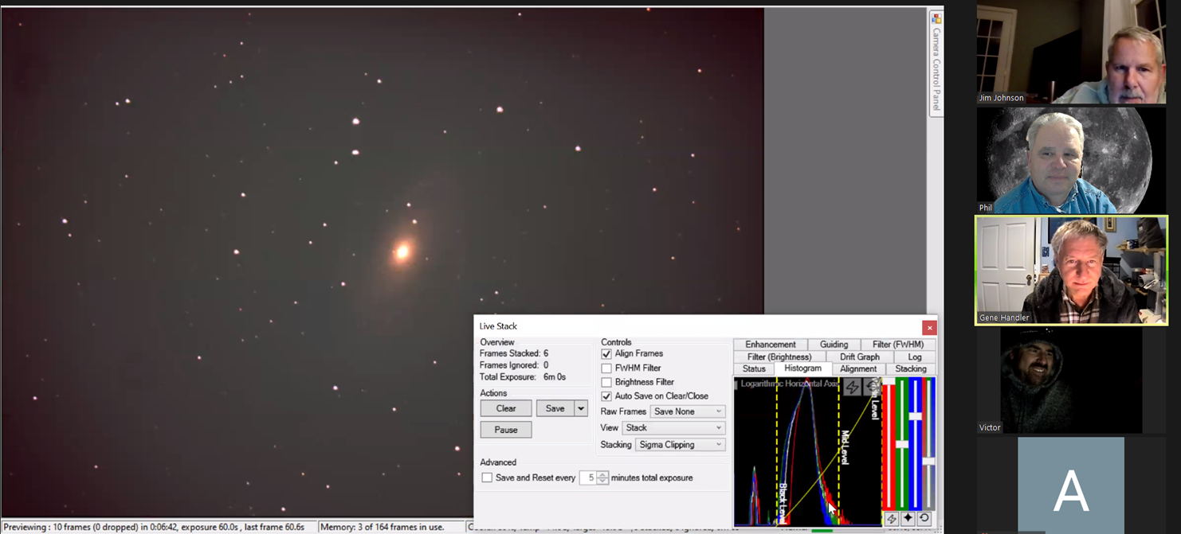
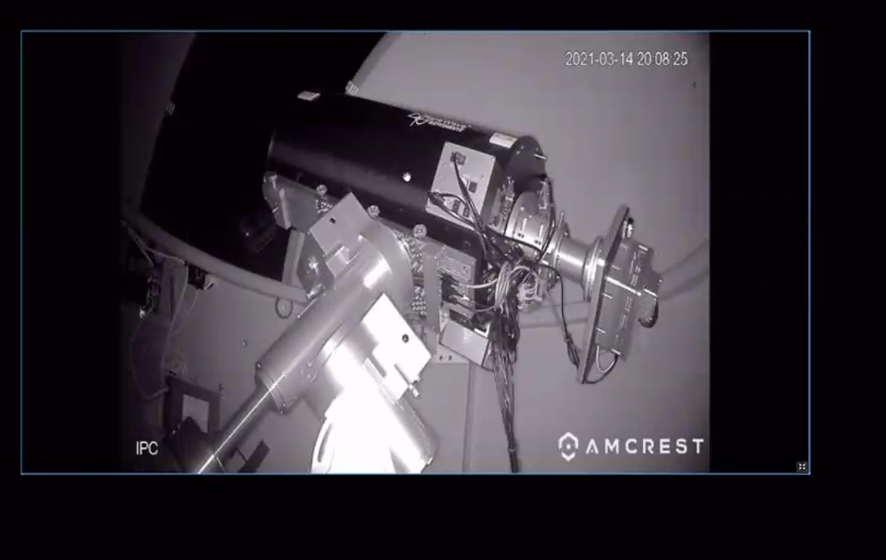
Public Star Party - Virtual
This Saturday Night
8:00PM
Check your email or HAL website for details

Slide 5
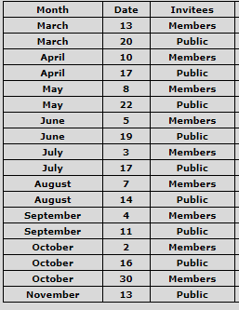
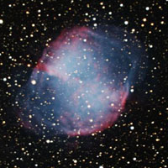
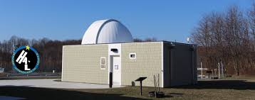
HAL Public Star Parties (Virtual and hopefully soon in-person)

Slide 6
Impromptu Star Parties
Alpha Ridge is open for a keyholder to call an Impromptu with the following provisions:
1) HALO will remain closed, except to the keyholder to turn off/on the parking lot and restroom lights and to turn on power to the exterior SE corner of HALO.
2) The restrooms are open.
3) The keyholder is responsible for closing the gate after entering and keeping lock separately until locking up at the end of the observing session.
4) Members will be informed that the gate is being left closed except for entry and exit. Members will be asked to open the gate inwards and close the gate behind them upon arrival and to repeat the routine upon departure.
5) Members will be reminded that all social distancing protocols currently called for in Howard County will be in effect.

Slide 7
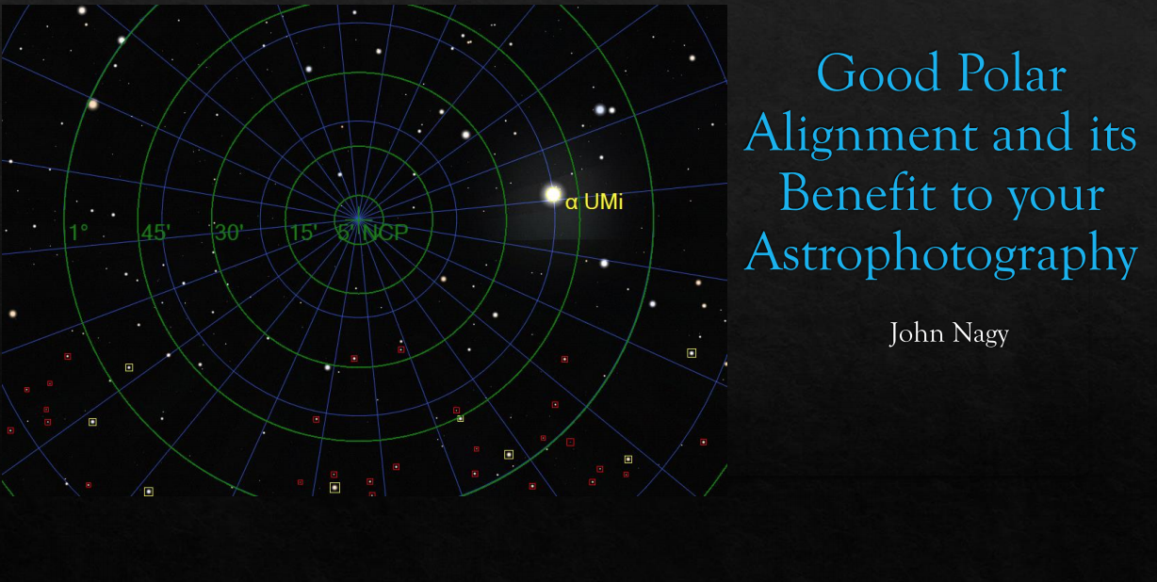
Astro-School Virtual April 8th – 7:00PM

Slide 8
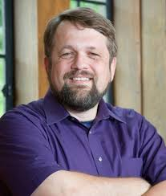

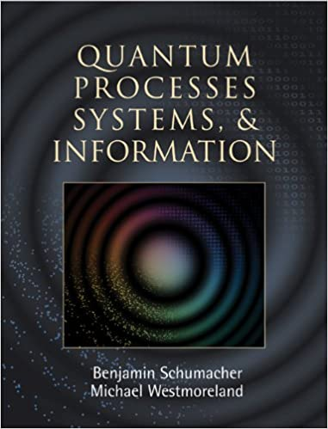
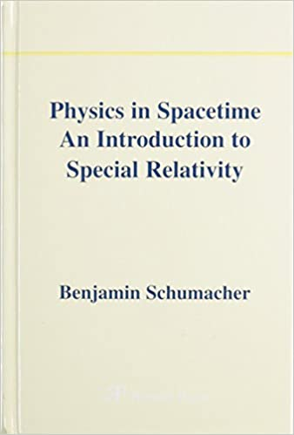




Tonight’s Guest Presenter
Dr. Benjamin Schumacher
Professor of Physics at Kenyon College
Topic: Gravity: The Force of Creation

Slide 9
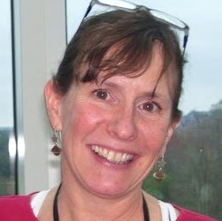
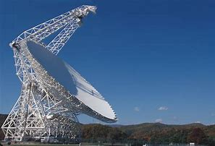
March Guest Presenter April 15th
Sue Ann Heatherly
Senior Education Officer
Green Bank Observatory
Topic: Greenbank Telescope

Slide 10
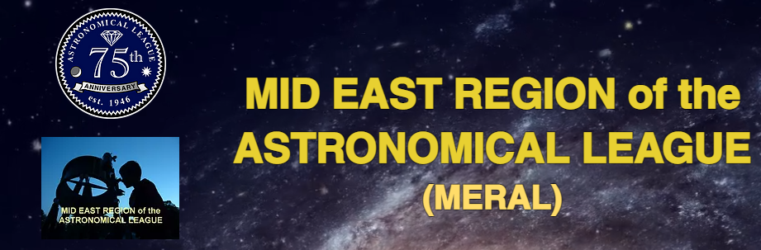
Northeast Astronomy Forum, April 10 – 11, Rockland Community College, NY (Not in MERAL). Virtual event - https://www.neafexpo.com/
Astronomy Day, May 15, Northern Virginia Astronomy Club - C.M. Crockett Park, Midland, VA. This event might need to be virtual this year due to health concerns, that is yet to be determined. https://www.novac.com/wp/outreach/astronomyday/
Cherry Springs Star Party, June 10-13. https://www.facebook.com/CherrySpringsStarParty/
Green Bank Star Quest, July 7-10 Green Bank WV. Final decision yet to be made. http://www.greenbankstarquest.org/
Stellafane, August 5-8 (Not in MERAL), Springfield, Vermont. Website indicates the event is a go. https://stellafane.org/
Almost Heaven Star Party at Spruce Knob Mountain Center in Circleville, WV over Labor Day weekend, 3 -7 Sep, 2021. https://www.ahsp.org/
York County Star Party Sept 8-12 and Oct 6-11. http://www.skyshedpodpa.com/york-county-star-party.html
Blackwater Falls Astronomy Weekend, September 9 – 11, Blackwater Falls State Park, WV. http://kvas.org/events.html
Staunton River Star Party (Fall), October 4 - 10, 2021, Staunton River State Park, Virginia http://chaosastro.org/starparty/
Northern Virginia Astronomy, Star Gaze, 10/9 Typically hosted at C.M. Crockett Park, Midland, VA. https://www.novac.com/wp/outreach/stargaze/
South Jersey Astronomy Club Star Party. No fall star party date is currently listed. http://www.sjac.us/star-party/
Mega Meet, Pulpit Rock, PA. No date is currently listed. https://lvaas.org/page.php?page=megameet
Black Forest Star Party, the date is to be determined. https://bfsp.org/
Delmarva Star Watch, Trap Pond DE. No information available, no website.

Slide 11
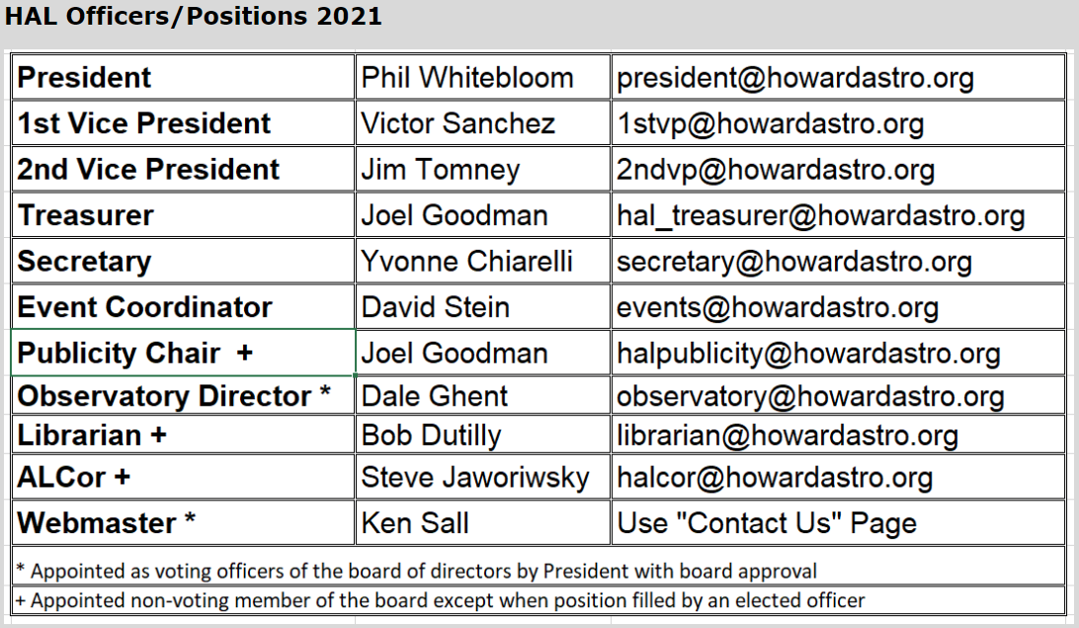
Officer Reports

Slide 12
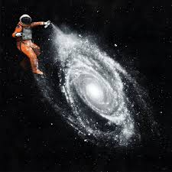
HAL Members Astro Art
And Projects

Slide 13
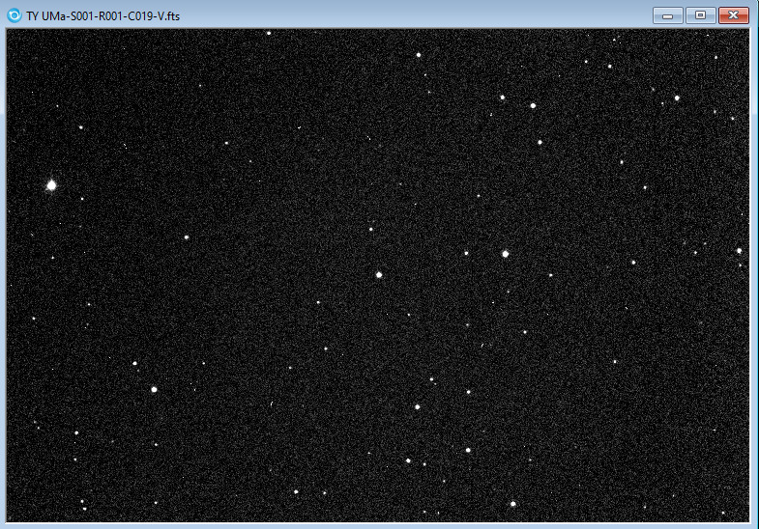
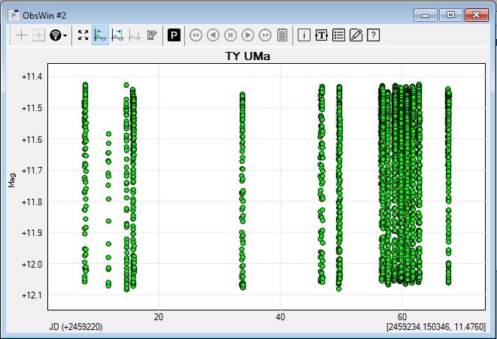
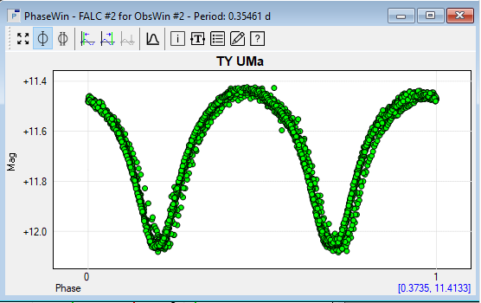
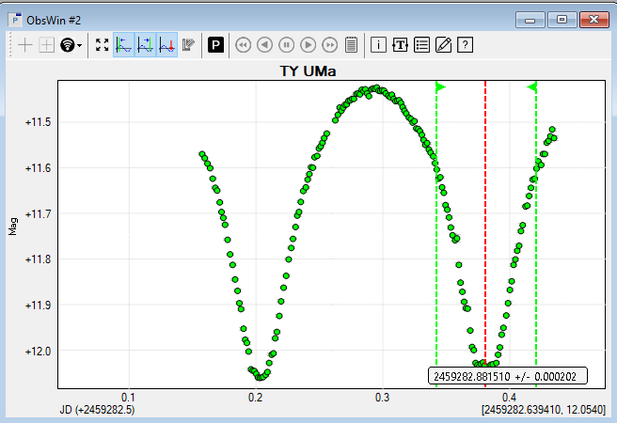
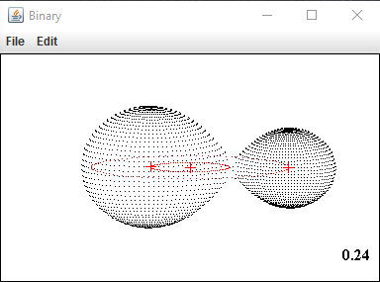
TY UMa EW-type (Contact Binary) Project Workflow
Eclipsing Binary Project
by Chuck Cynamon
Mt Airy Obs
PW CDK 12.5”
SBIG STXL-6303e
Paramount MX+
Filters
B: 120 sec
V: 90 sec
6-10 hr collections
2600+ obs
TY UMa
F-type stars
Vmag = 11.48 - 12.14
P= 0.3545 days
Check star
General Workflow
VPHOT Time Series
Peranso SW analysis
Period Analysis
Time of Min Analysis
O-C Diagram
Binary Maker Modeling
Comp stars

Slide 14
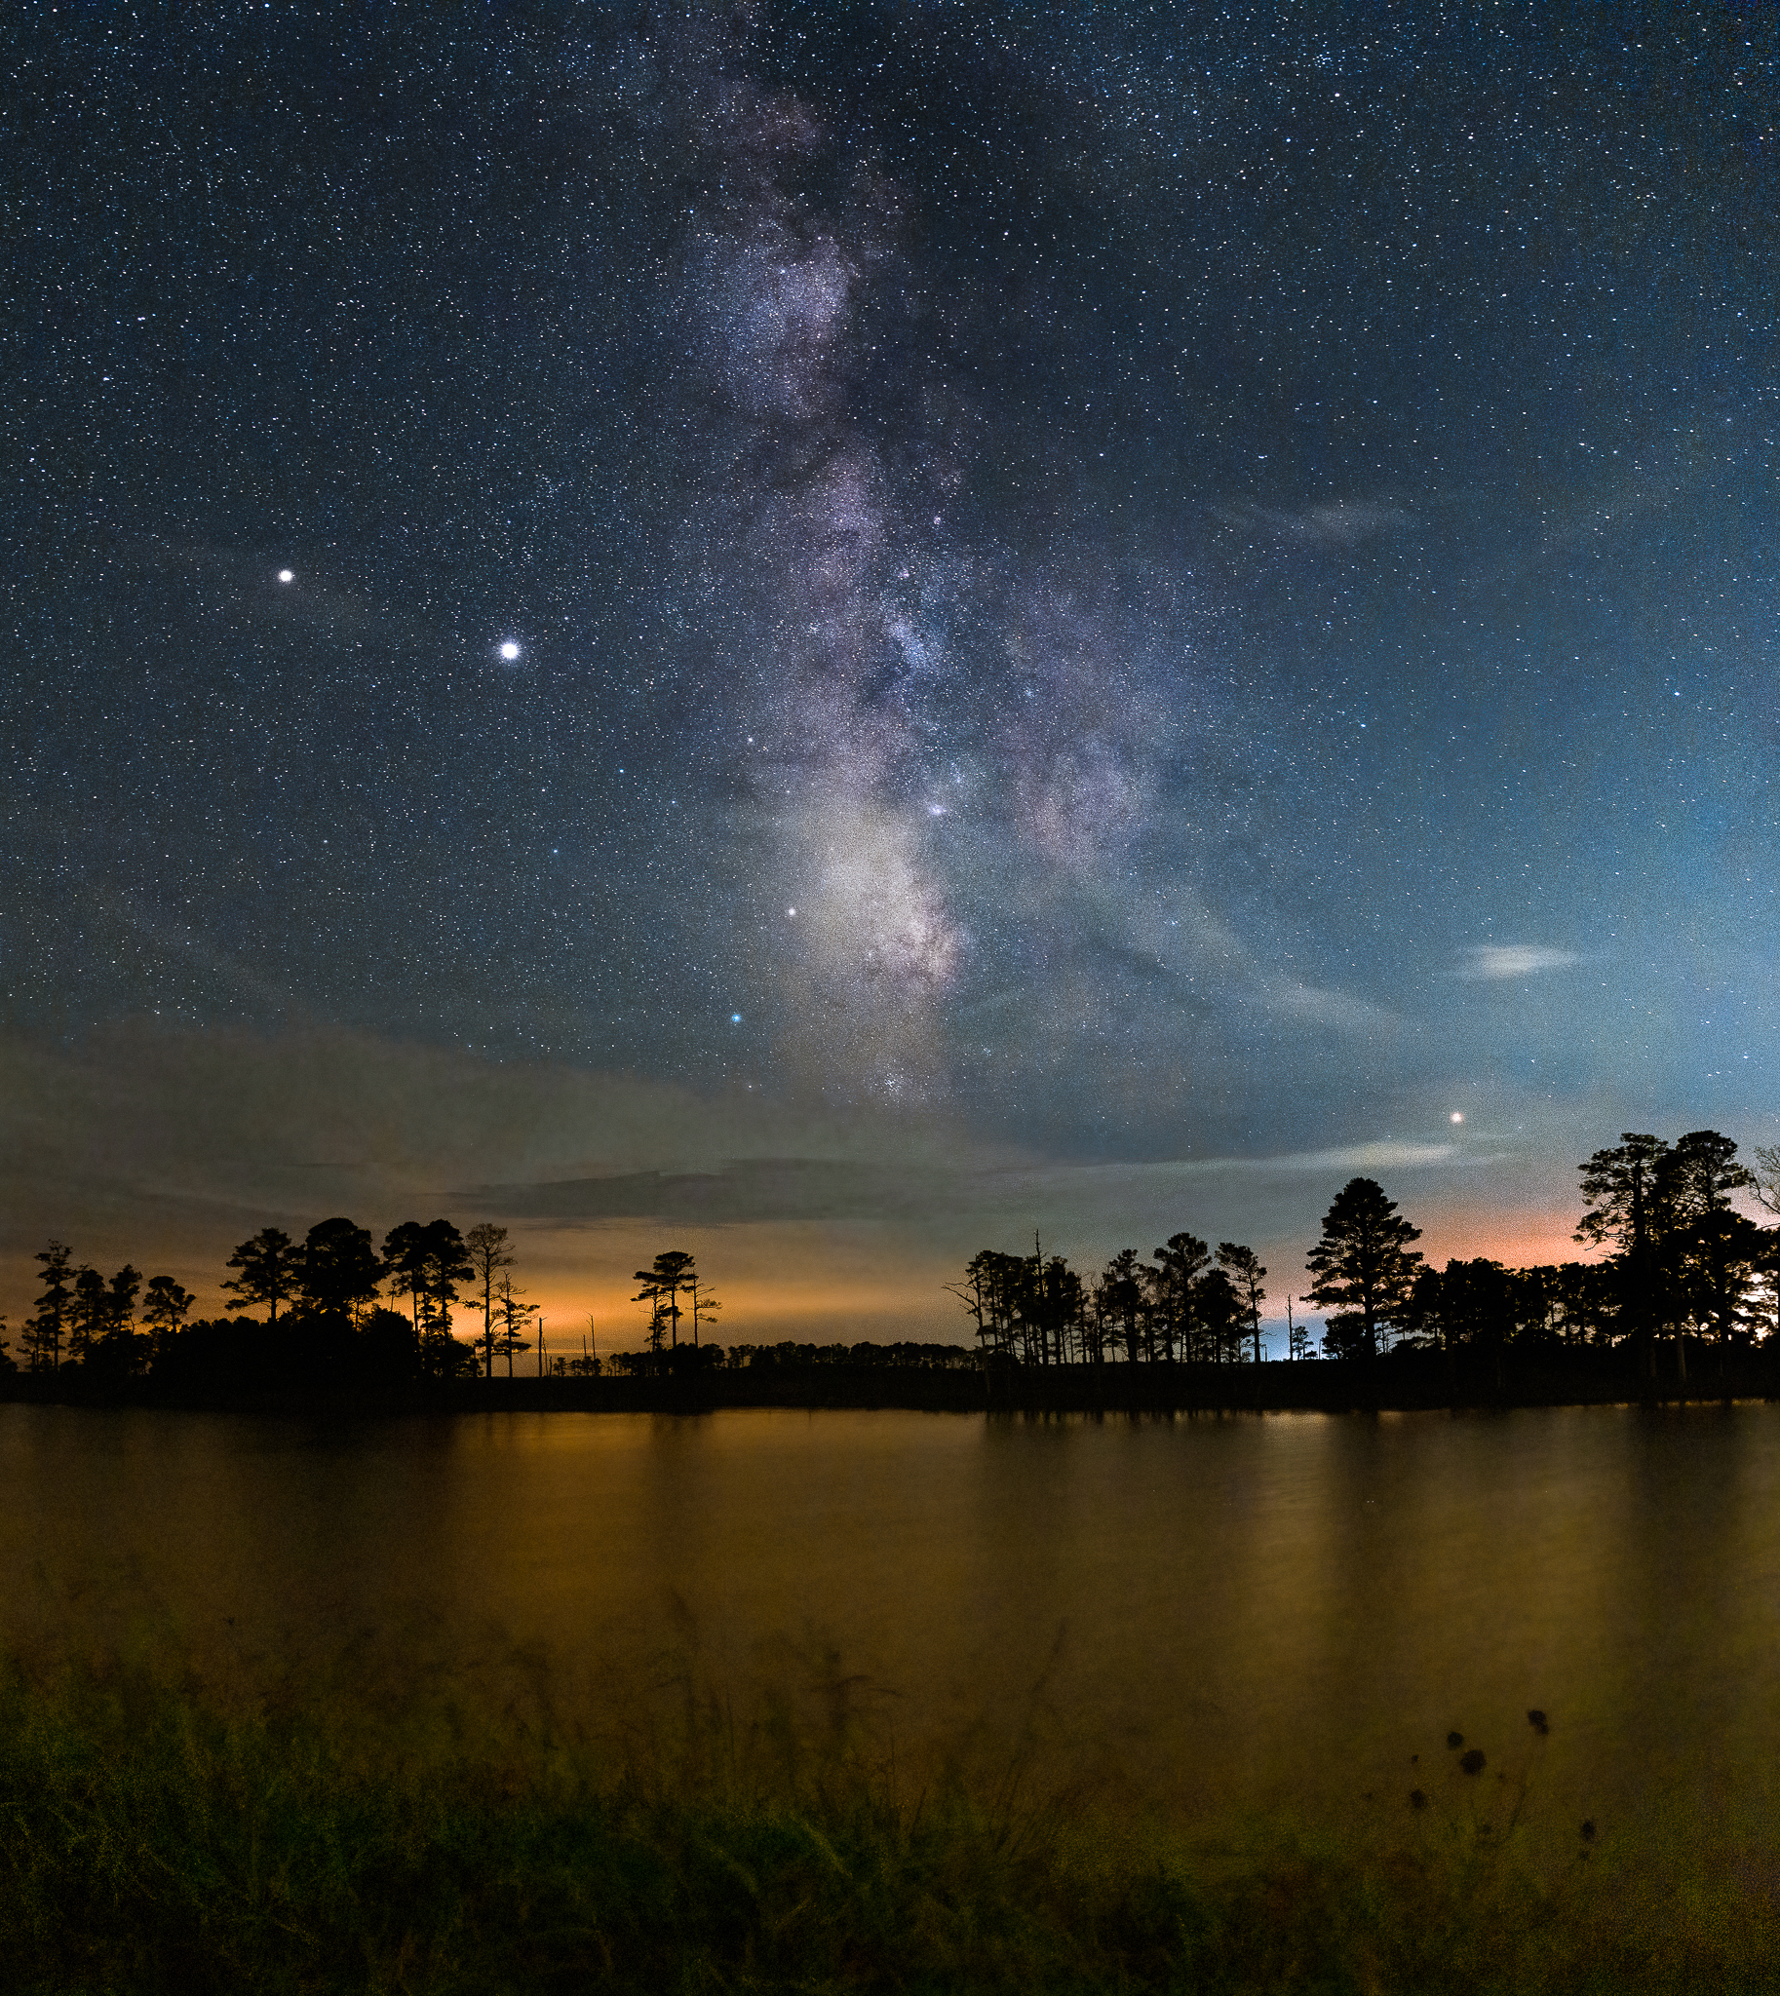
Cheryl Kerr

Slide 15
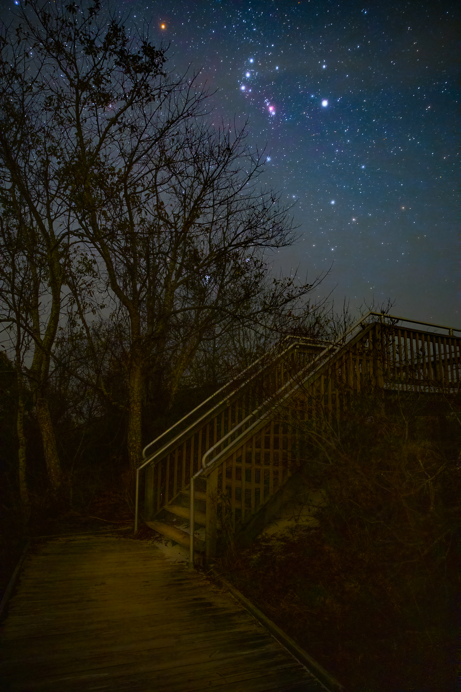
Cheryl Kerr
M2

Slide 16
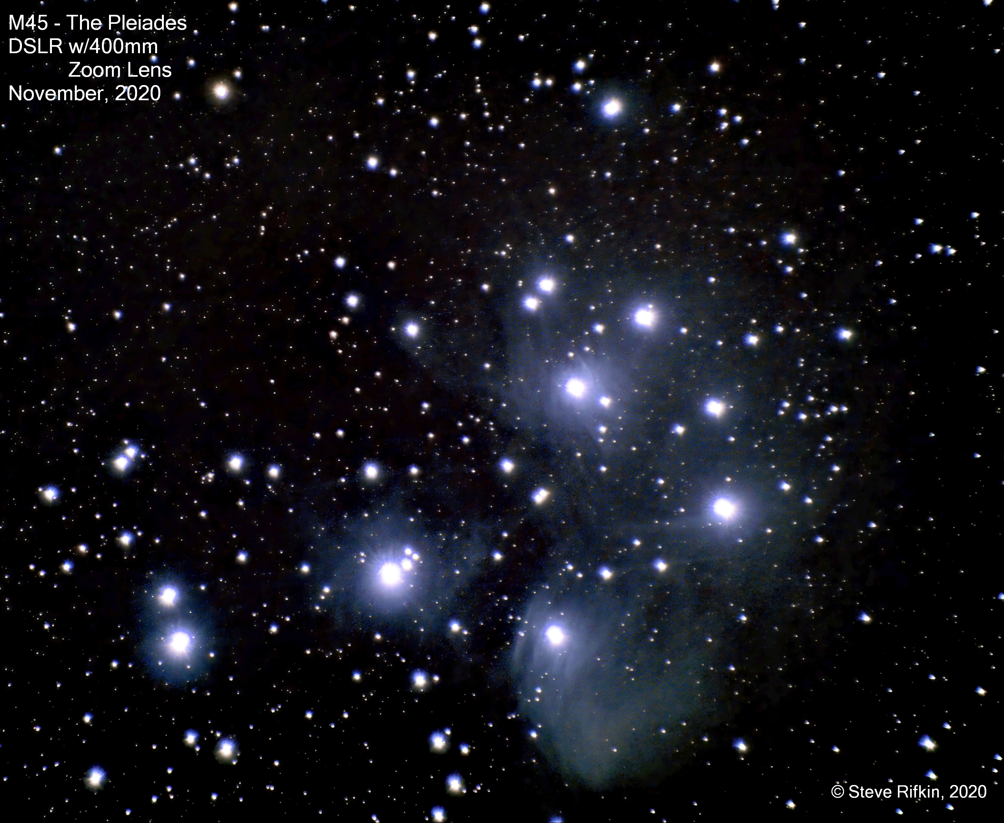

Slide 17
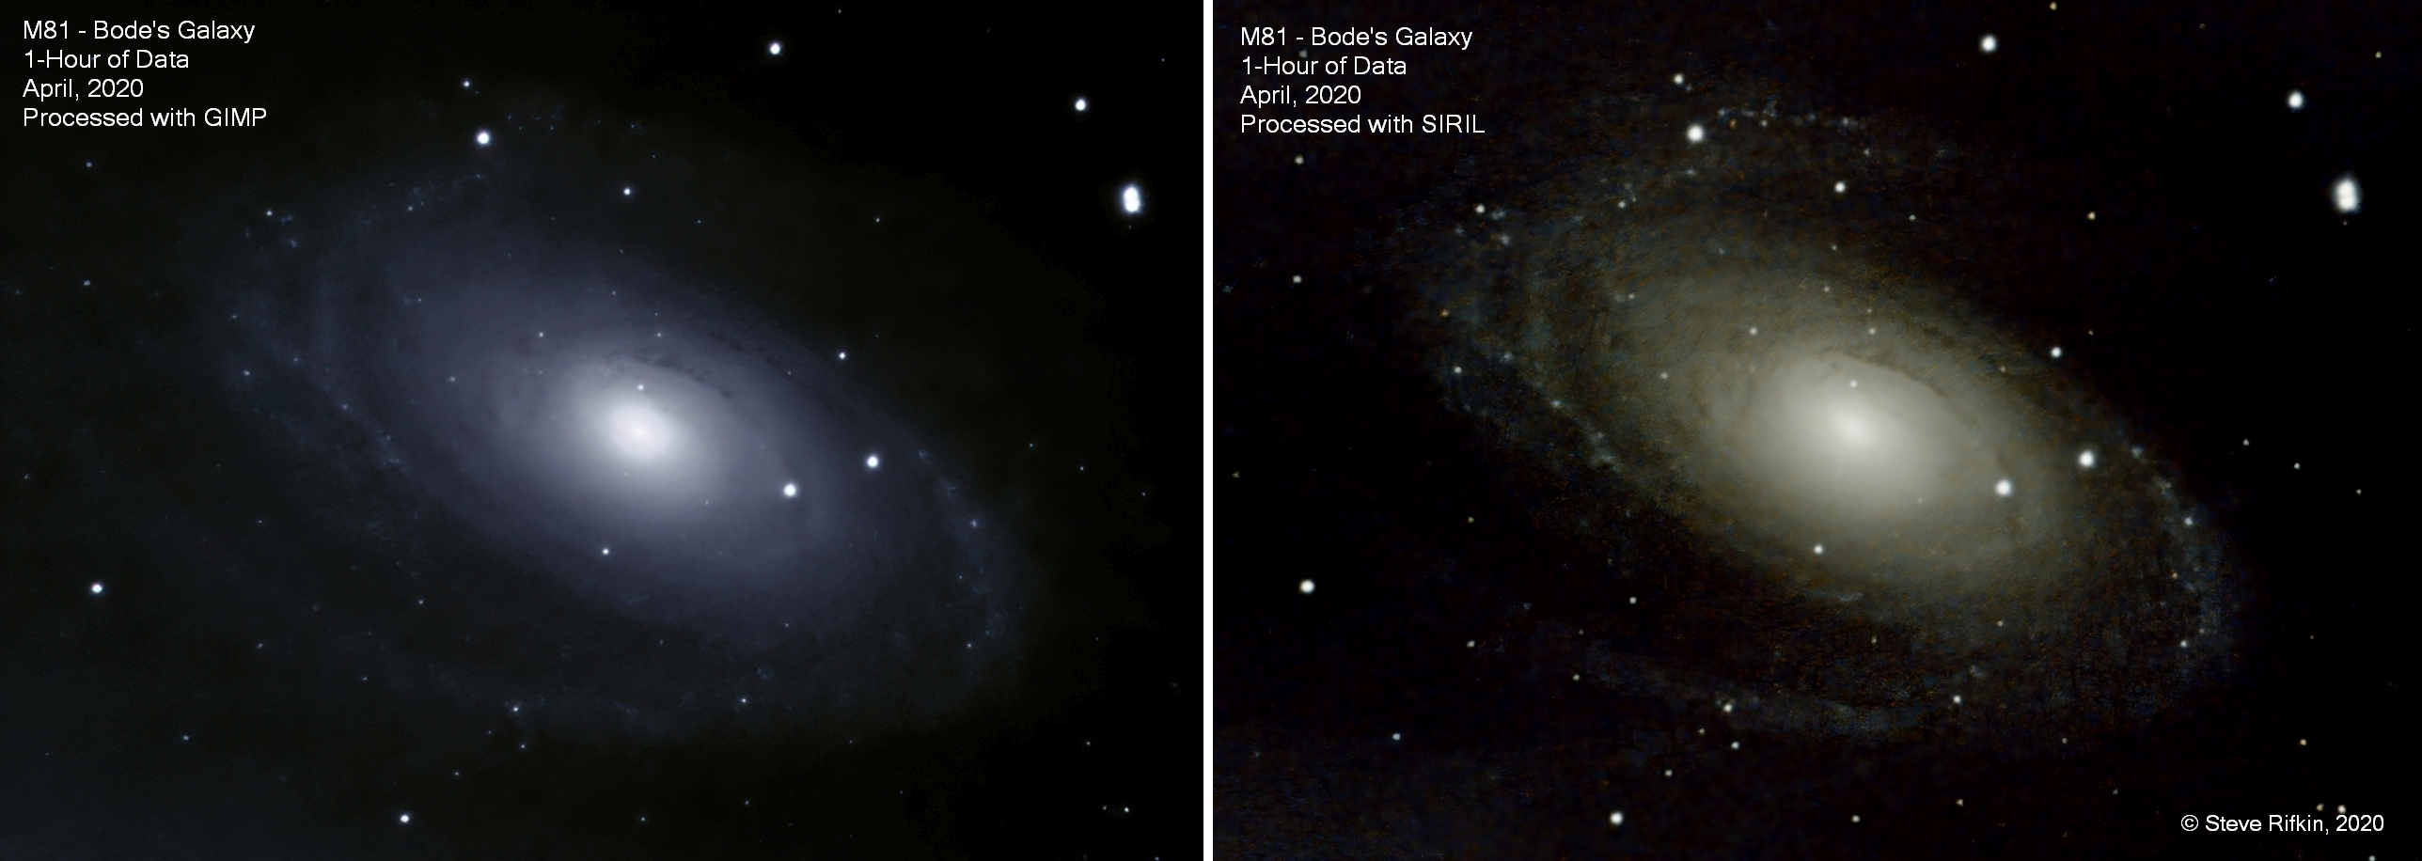

Slide 18
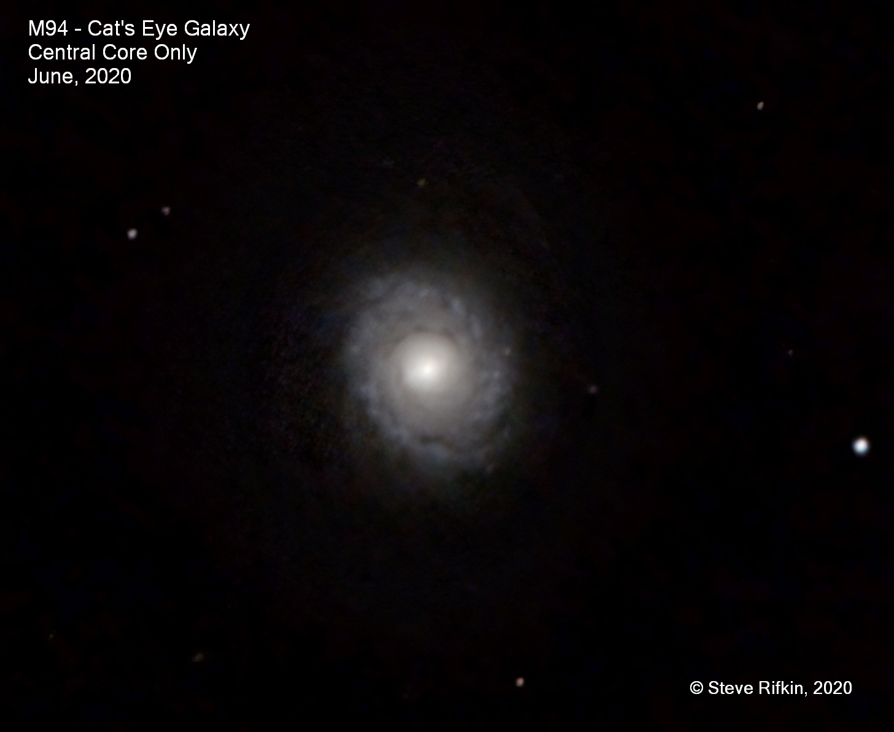

Slide 19
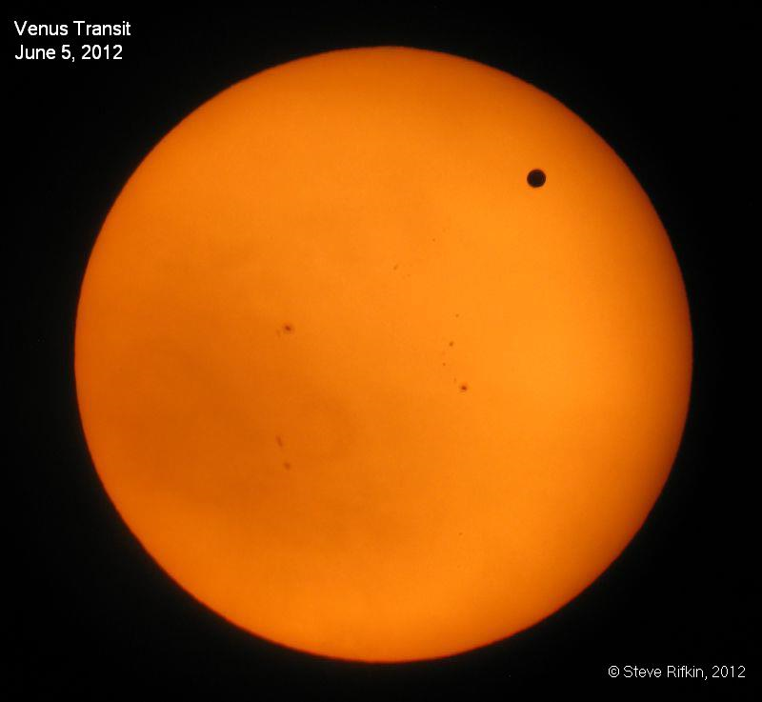

Slide 20
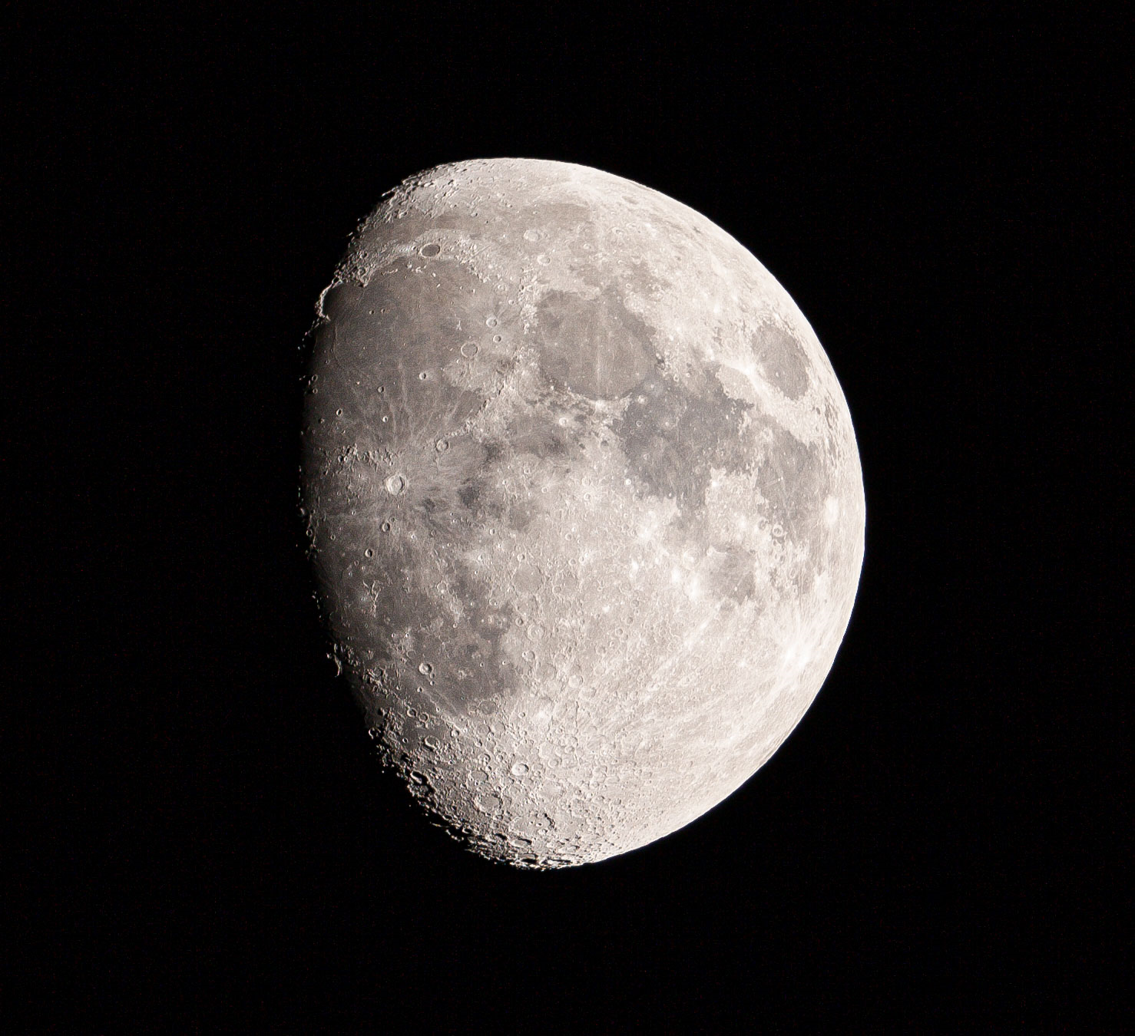
Brad Martin

Slide 21
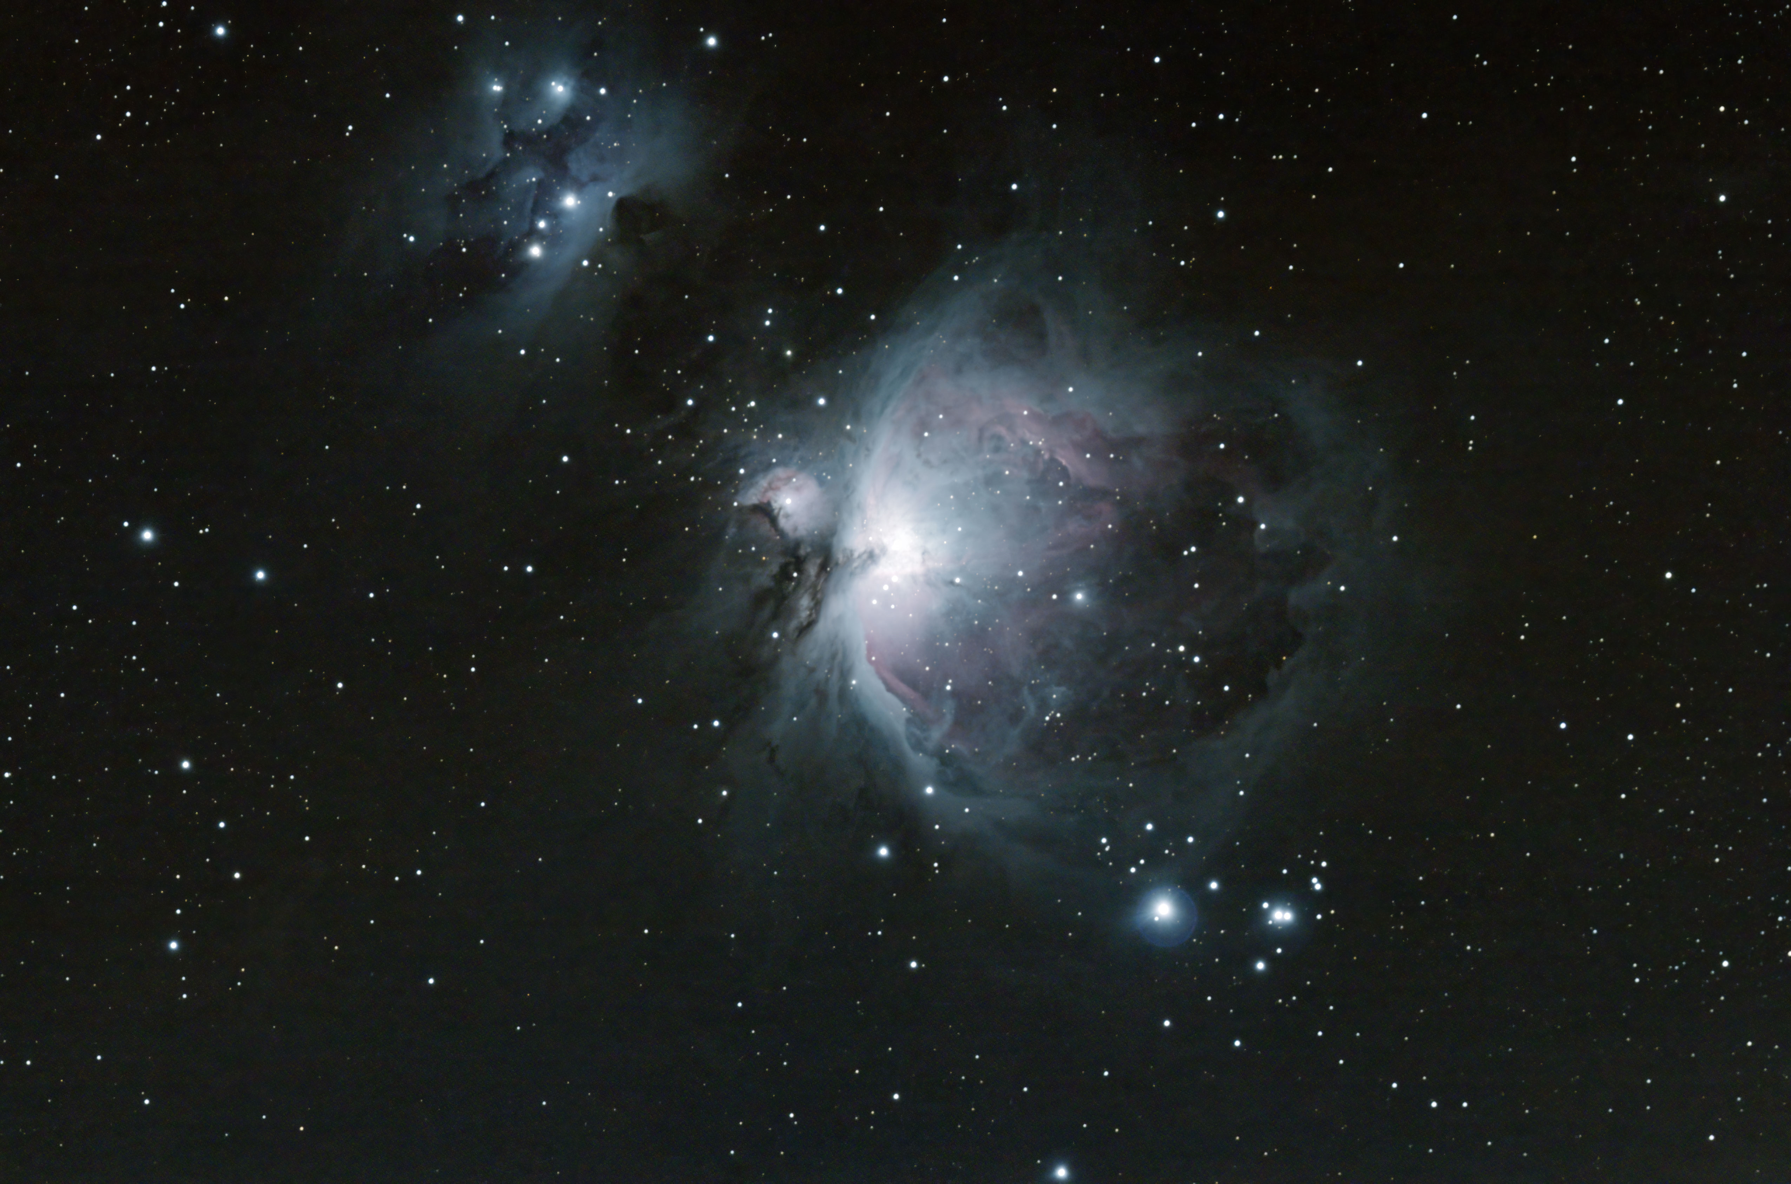
Brad Martin

Slide 22
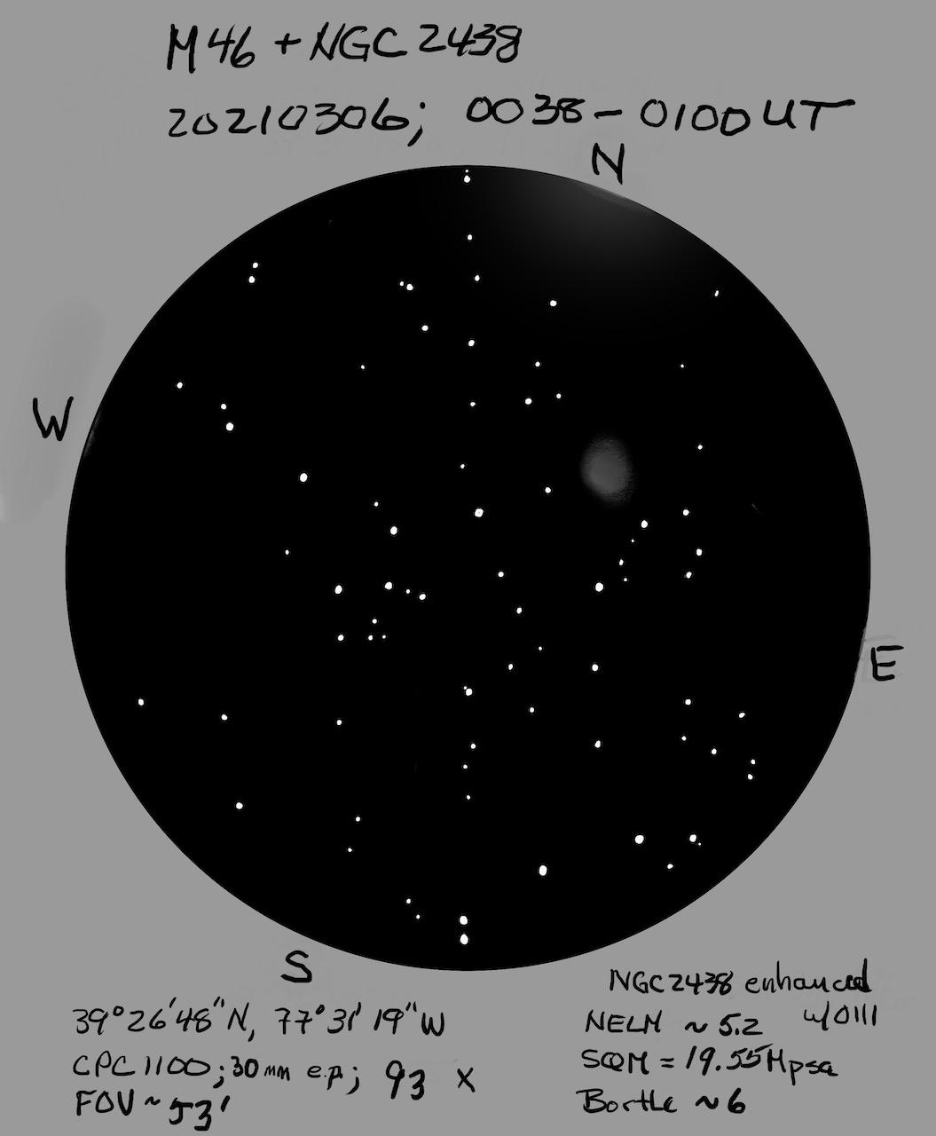
Steve Berte

Slide 23
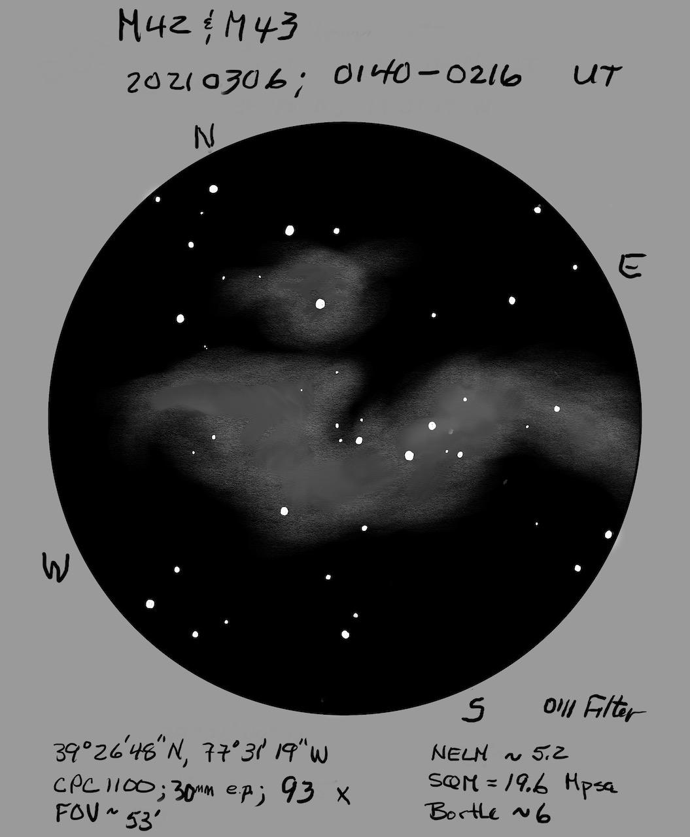
Steve Berte

Slide 24
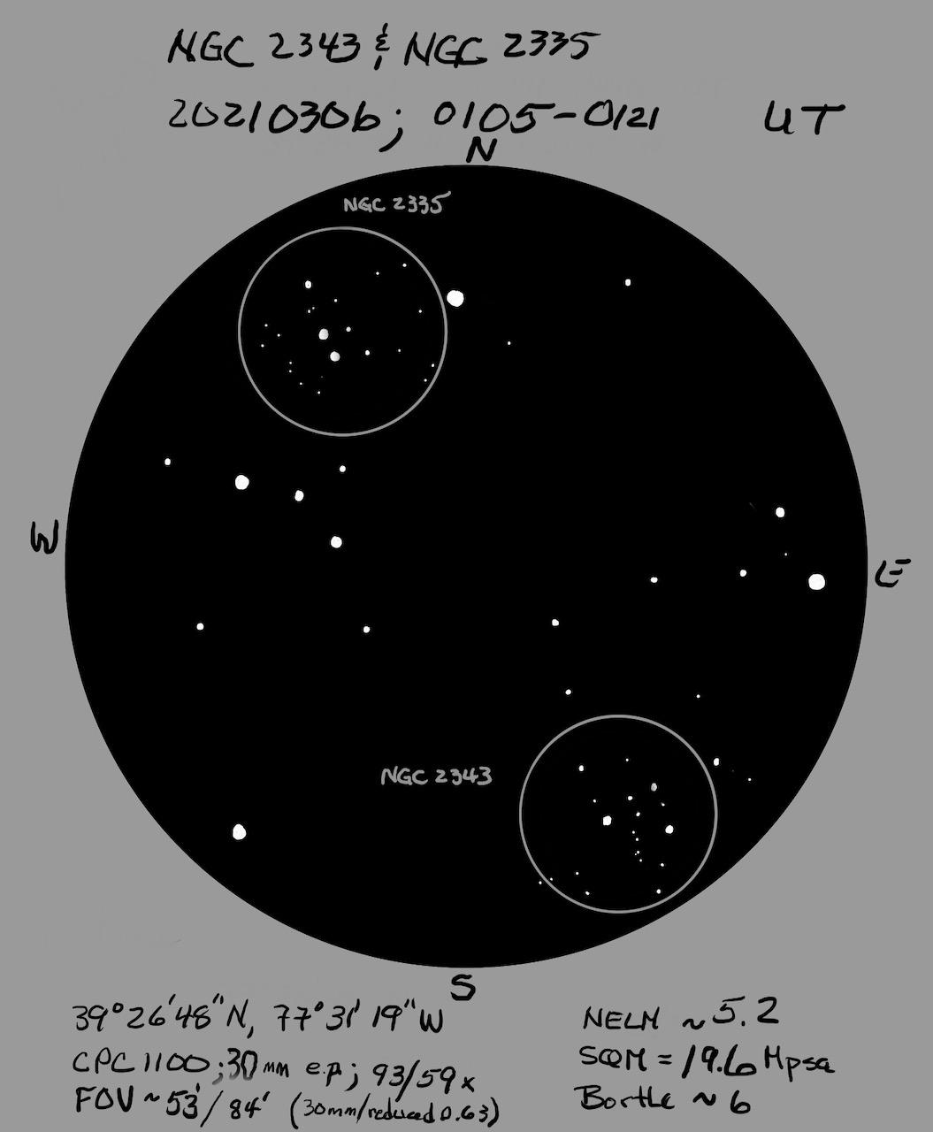
Steve Berte

Slide 25
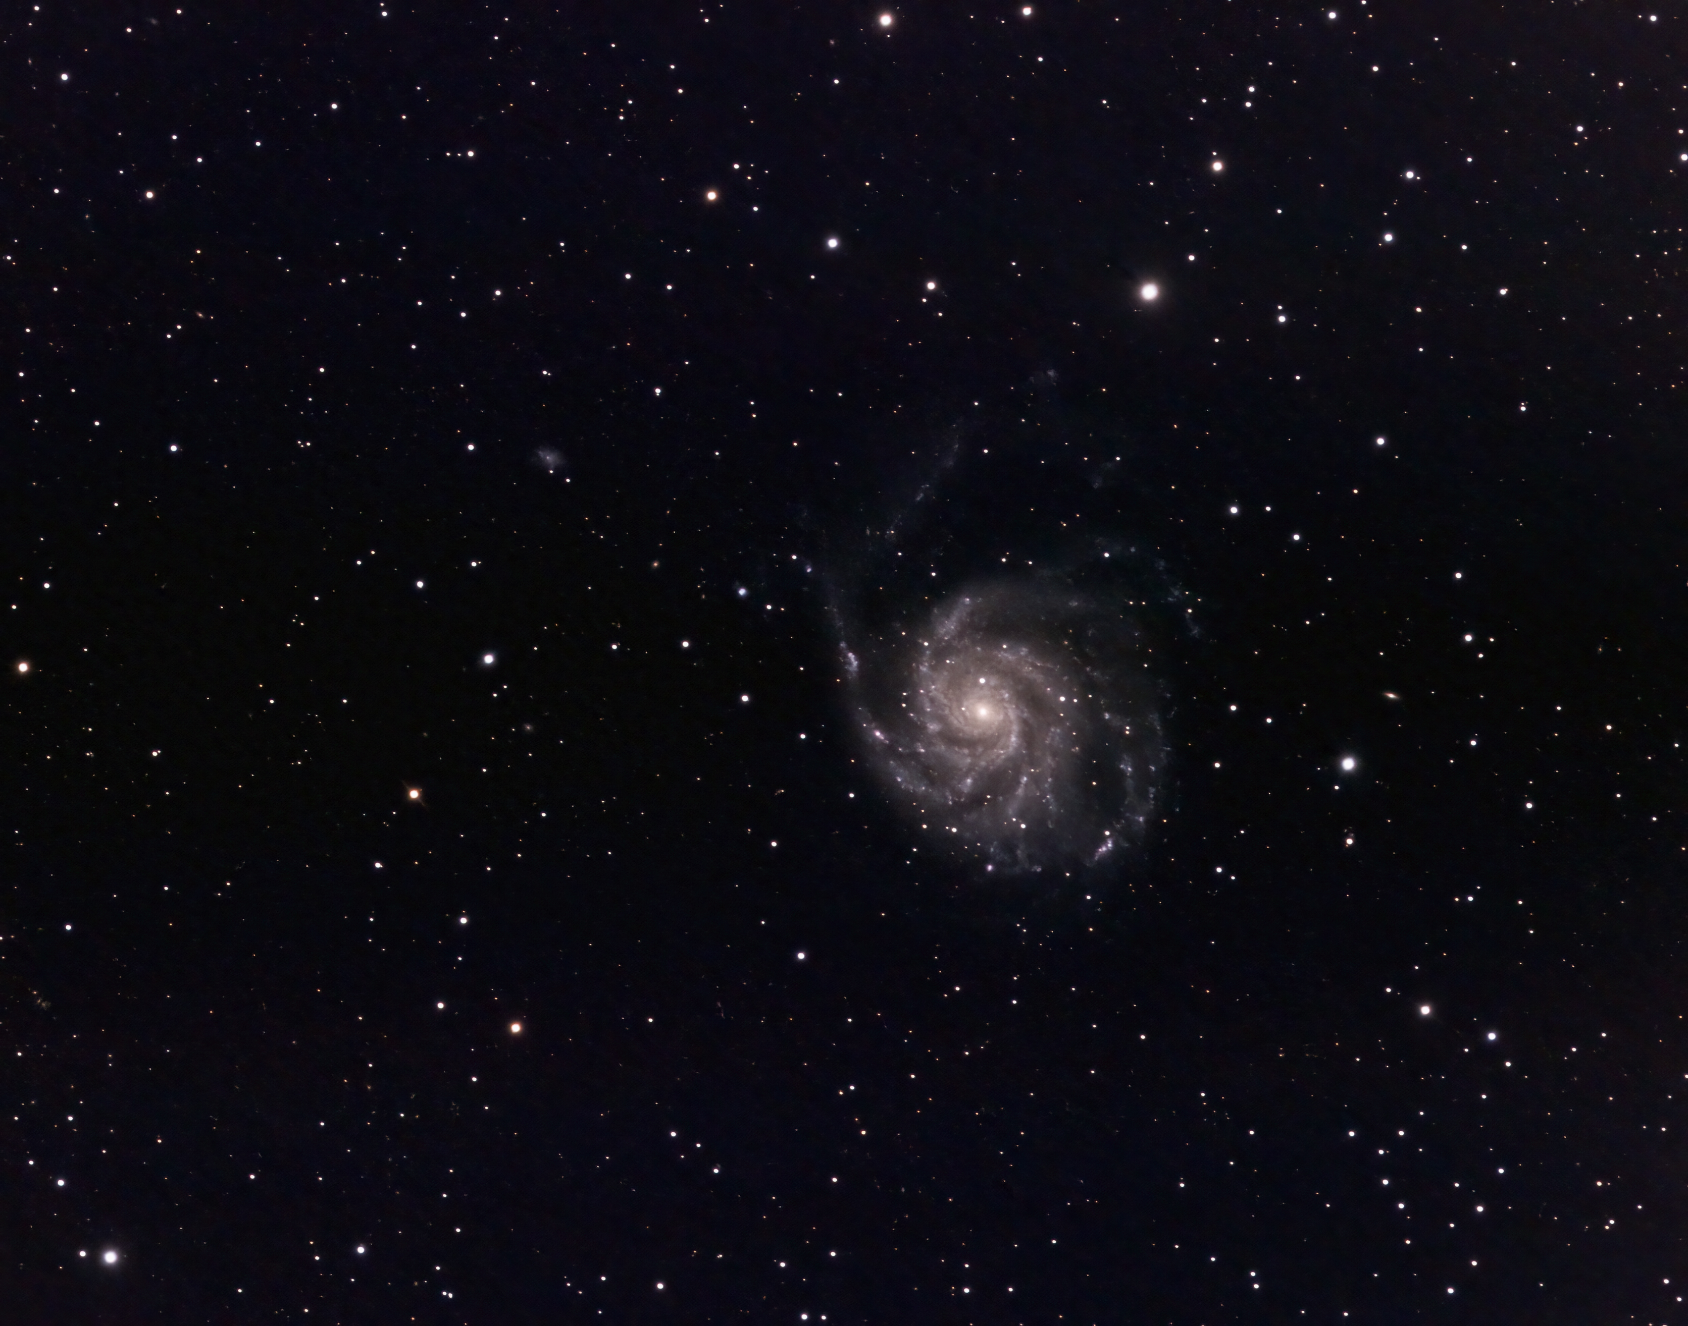
Brad Martin

Slide 26
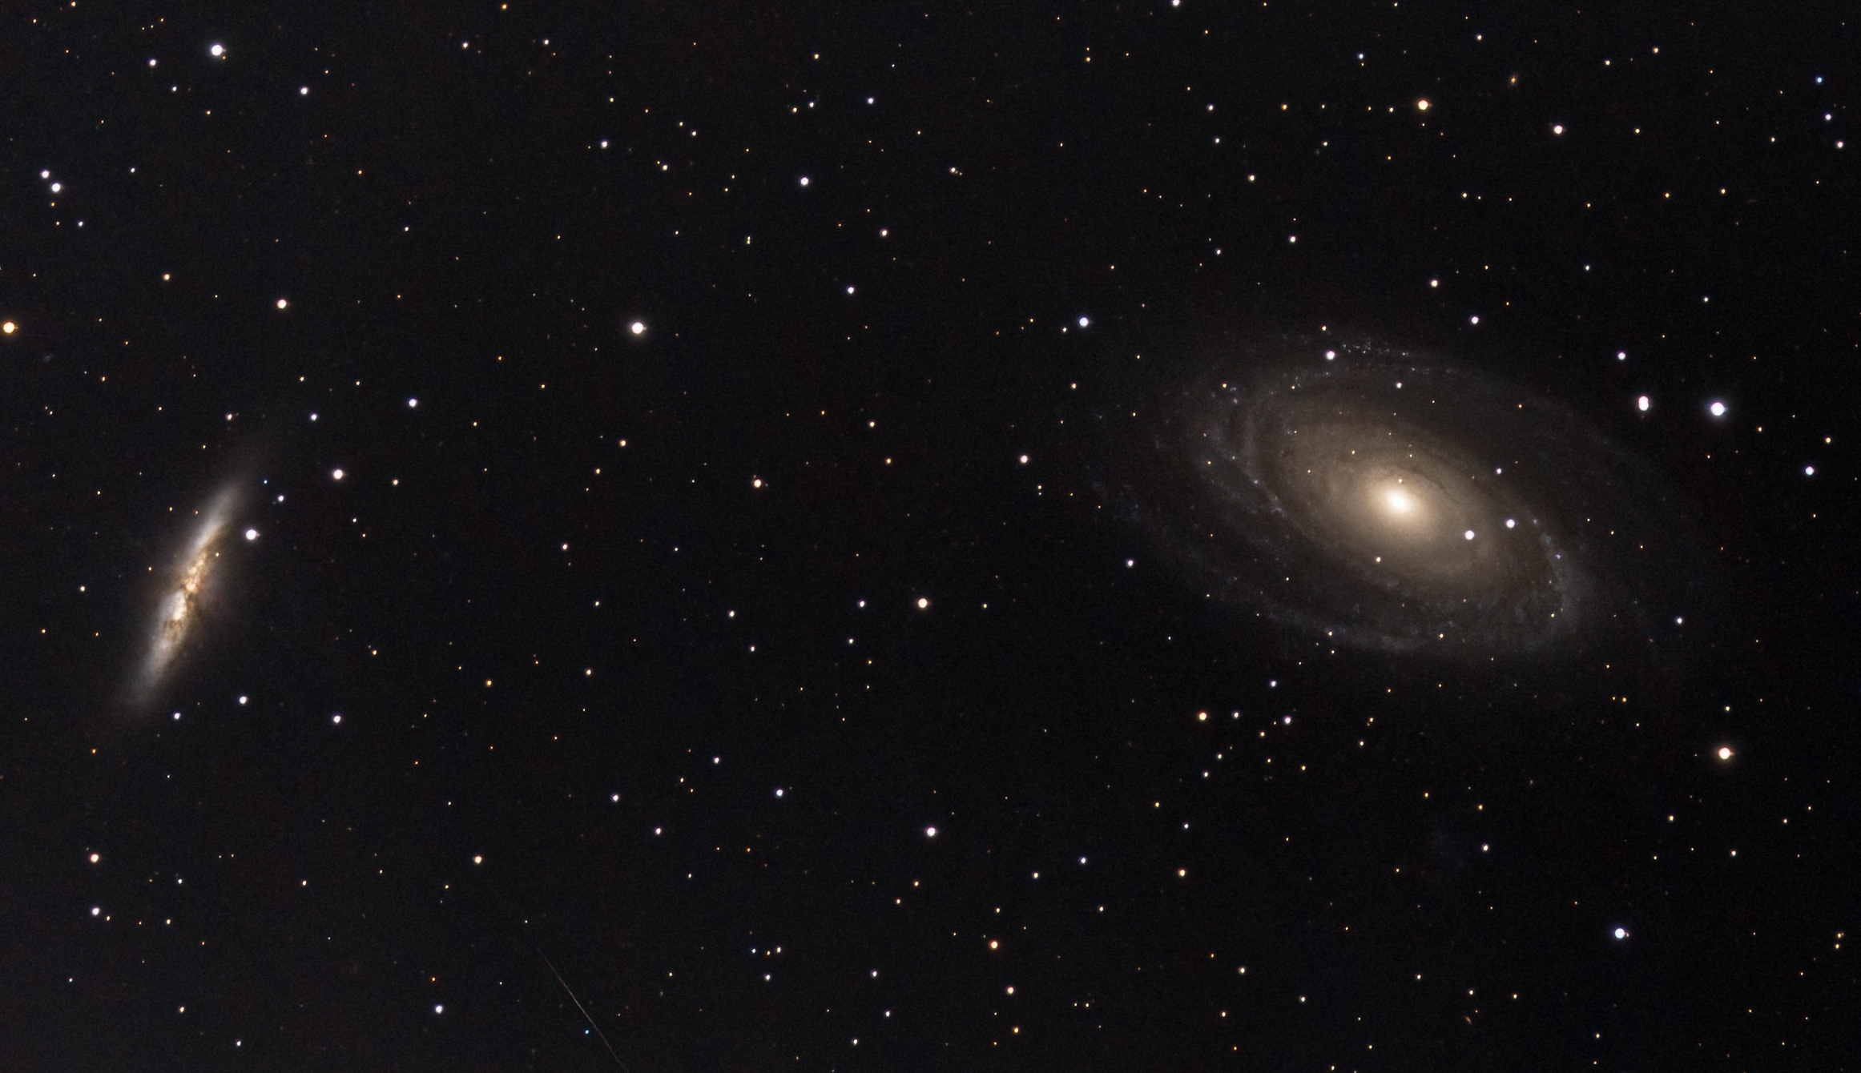
Brad Martin

Slide 27
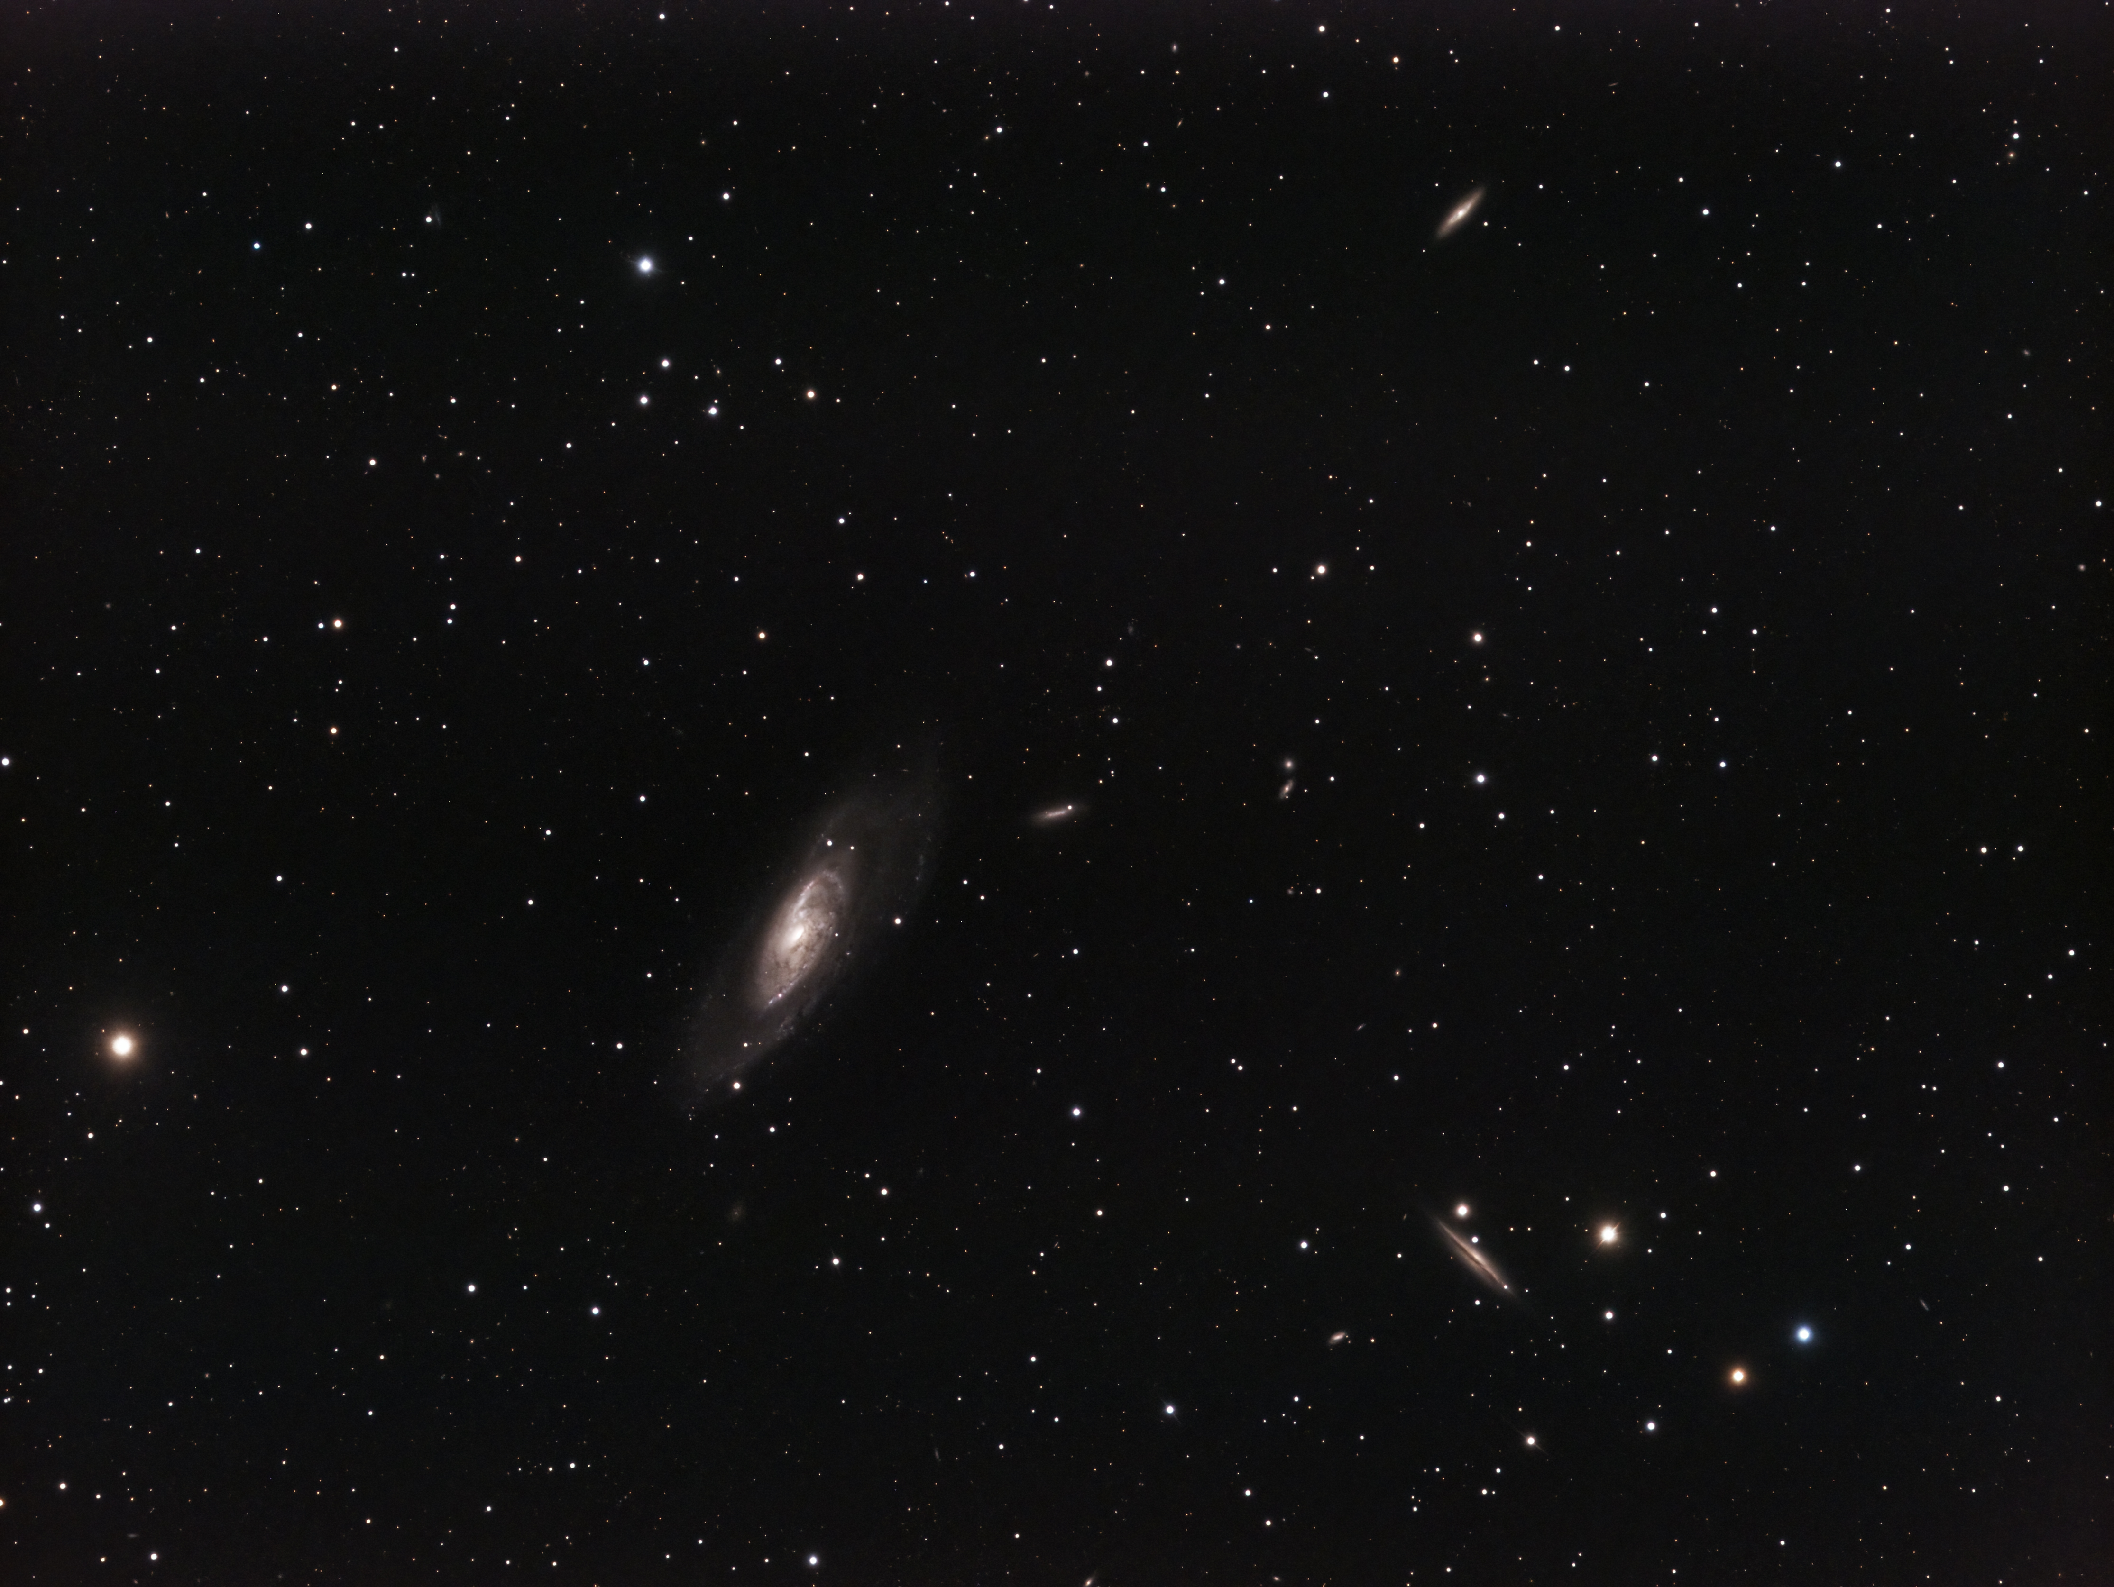
Brad Martin

Slide 28
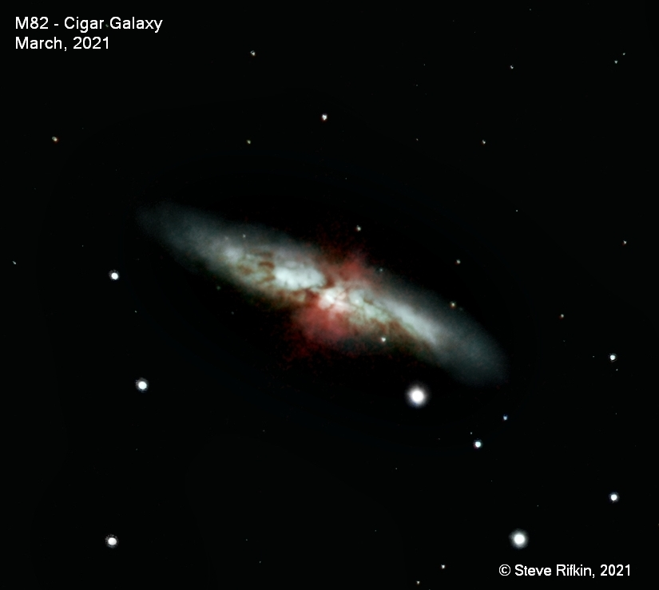

Slide 29
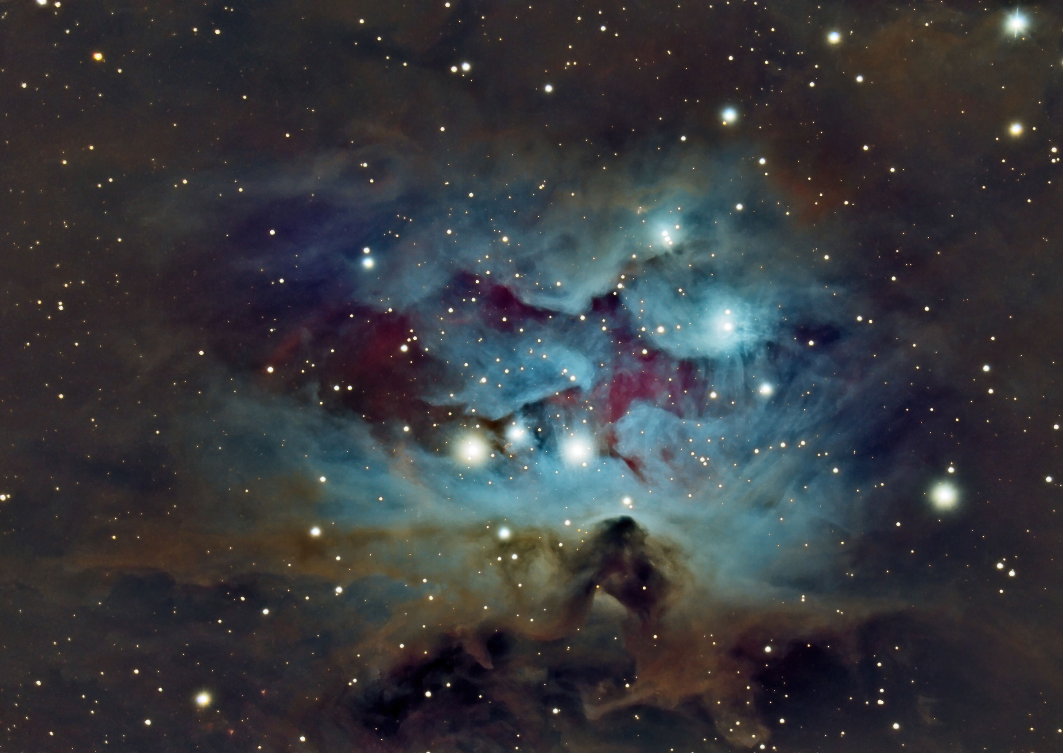
Victor Sanchez

Slide 30
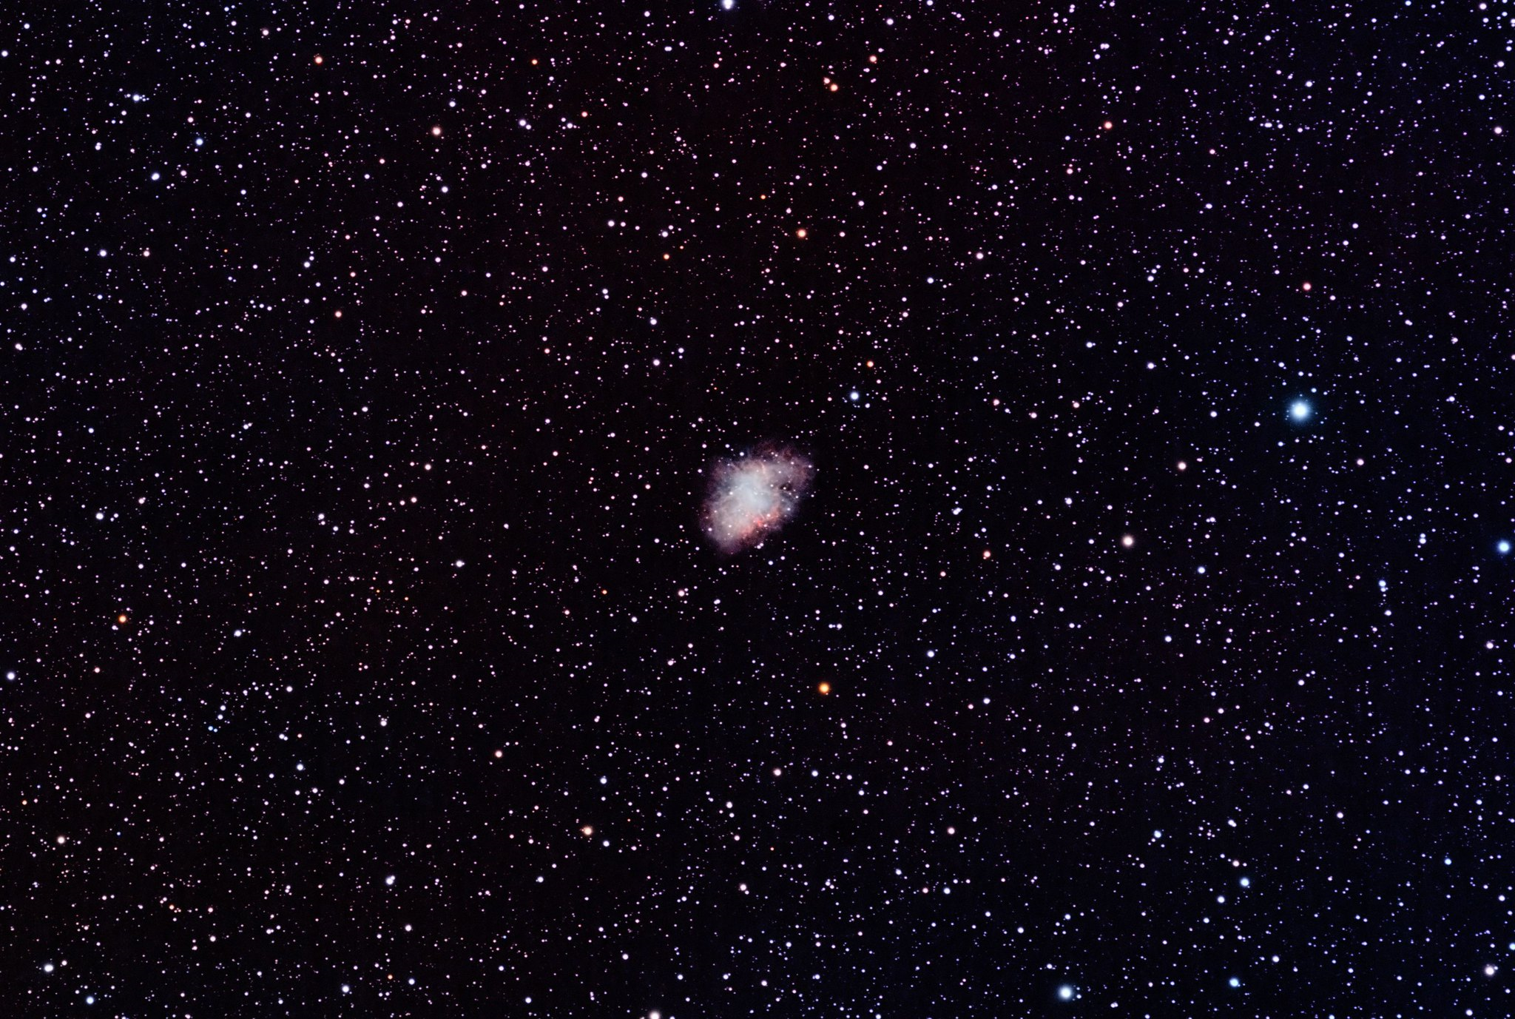
Jim Johnson

Slide 31
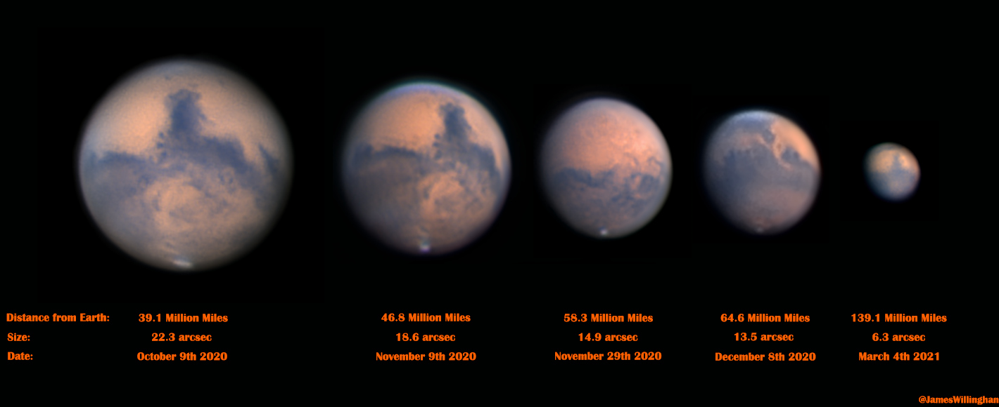

Slide 32
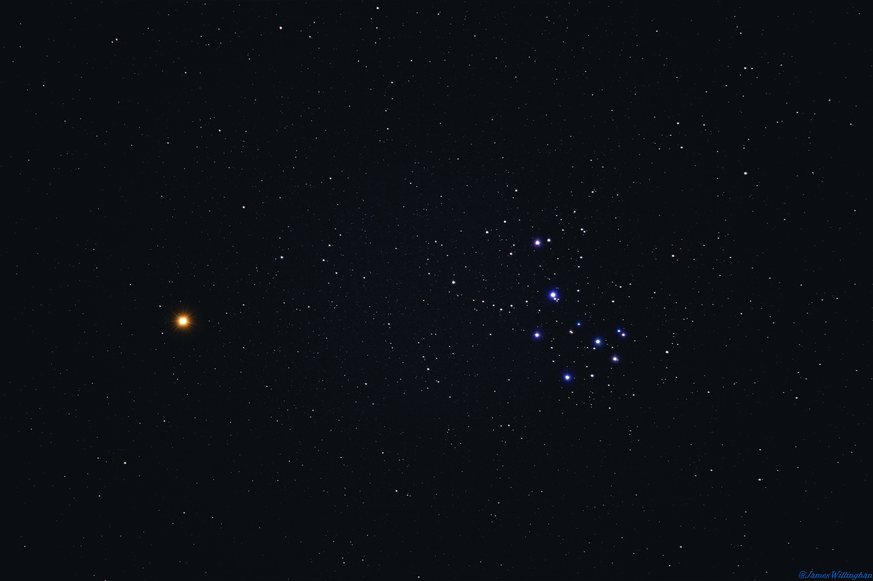

Slide 33
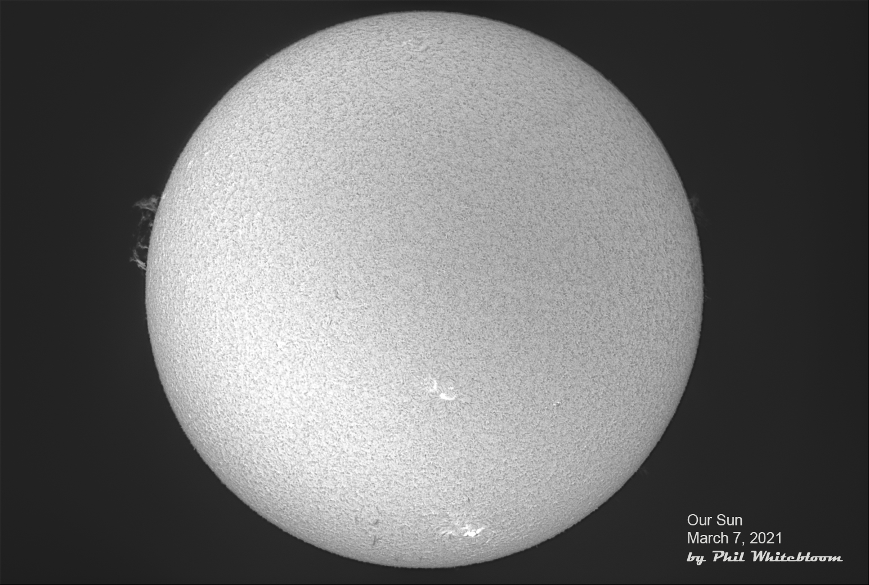
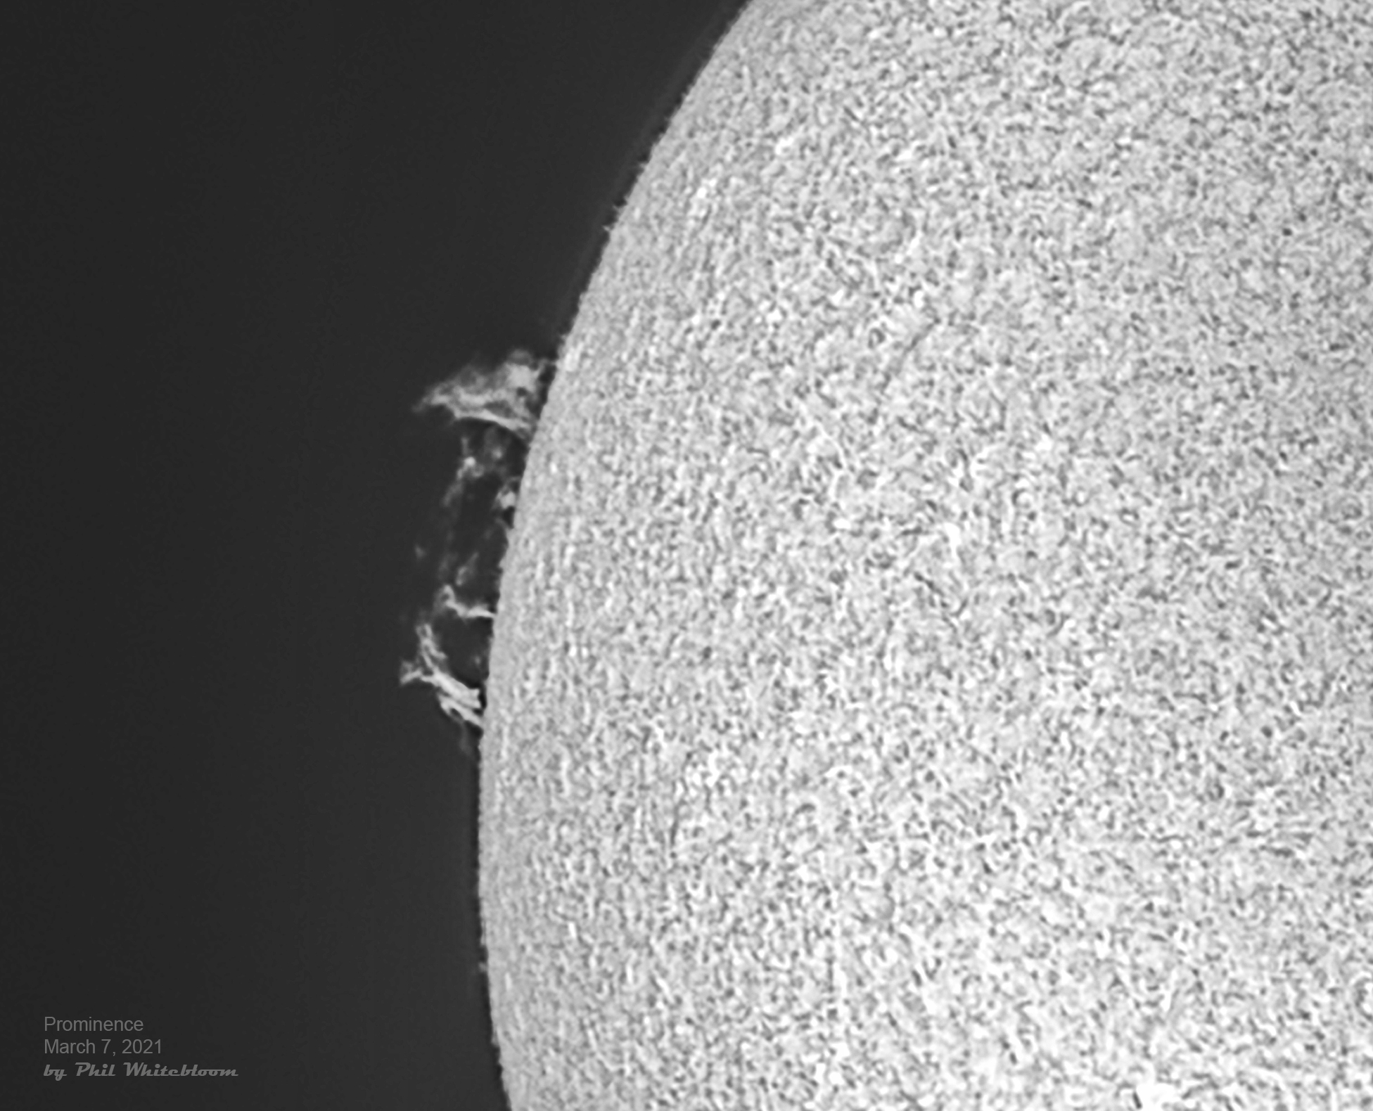

Slide 34
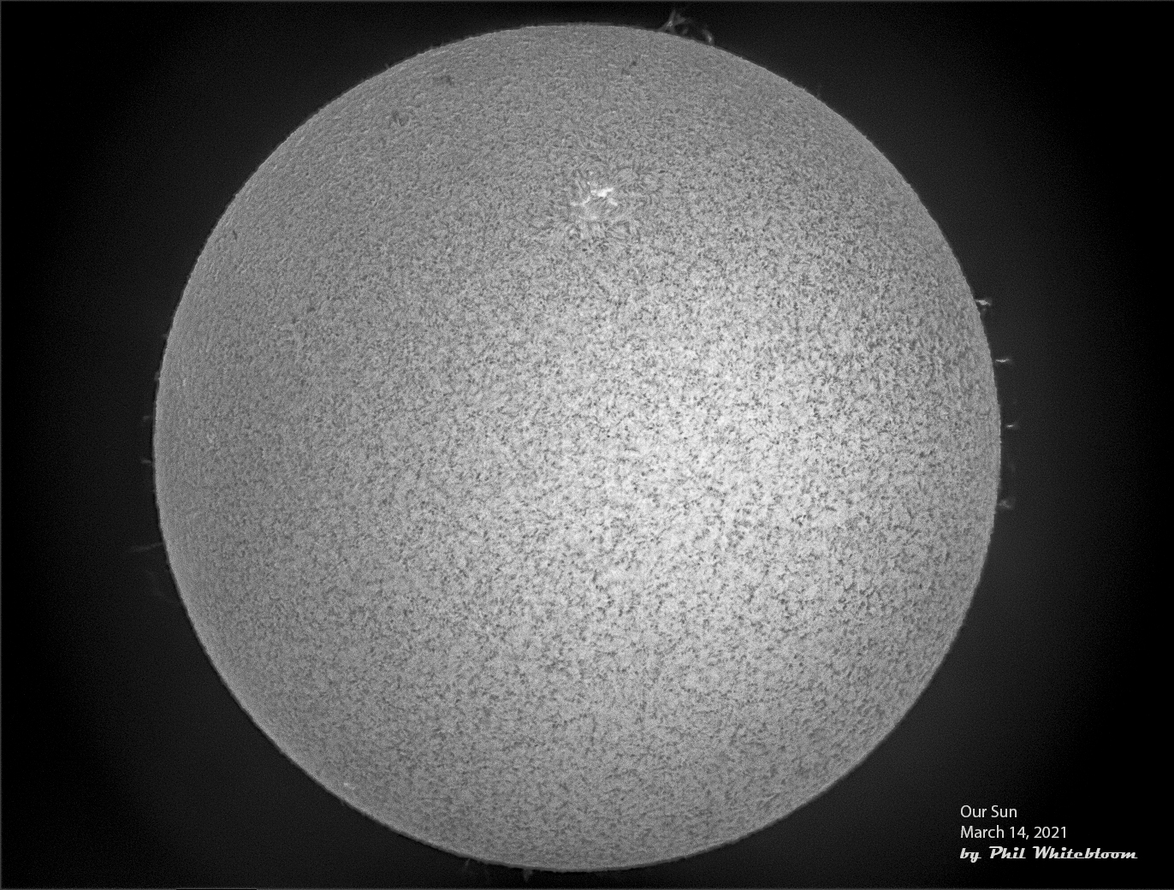

Slide 39
Thank You
CLEAR SKIES!
STAY HEALTHY!

